Slide 1



Substance Use, HIV, and Older Adults: What Clinicians Need to Know
TRAINER NAME
TRAINING DATE
TRAINING LOCATION
Notes:
TITLE SLIDE
The purpose of this introductory training is to provide HIV clinicians (including, but not limited to physicians, dentists, nurses, and other allied medical staff, therapists and social workers, and counselors, specialists, and case managers) with a detailed overview of substance abuse and HIV among older adults. The curriculum reviews important epidemiological data focused on older adult substance use trends and HIV prevalence; reviews standardized screening and assessment techniques to support the move to improve treatment effectiveness; and concludes with evidence-based and promising clinical strategies. The introductory training includes a 133-slide PowerPoint presentation, Trainer Guide, and a companion 2-page fact sheet. The duration of the training is approximately 90-120 minutes, depending on whether the trainer chooses to present all of the slides, or a selection of slides. For example, slides 113-118 represent information about interventions, and can be eliminated if you choose to have the audience participate in a discussion of interventions on slide 112.
“Test Your Knowledge” questions have been inserted at the beginning and end of the presentation to assess a change in the audience’s level knowledge after the key content has been presented. An answer key is provided in the Trainer’s notes for slides 6-10 and slides 128-132.

Slide 2
Training Collaborators
Los Angeles Pacific AIDS Education and Training Center
Pacific Southwest Addiction Technology Transfer Center
UCLA Integrated Substance Abuse Programs
2
Notes:
This PowerPoint presentation, Trainer Guide, and companion fact sheet were developed by Jim Peck, PsyD and Andrew Kurtz, MFT through supplemental funding provided by the Los Angeles Pacific AIDS Education and Training Center, based at Charles R. Drew University of Medicine and Science. We wish to acknowledge Phil Meyer, LCSW, Maya Gil-Cantu, MPH, Kevin-Paul Johnson, and Tom Donohoe, MBA, from the LA PAETC.

Slide 3

Introductions
Briefly tell us:
What is your name?
Where do you work and what you do there?
Who is your favorite musician or performer?
What is one reason you decided to attend this training session?
Richell
Bob
Mary
Jose
Derrick
Sherry
Bethany
Tom
3
Notes:
INSTRUCTIONS
In an effort to break the ice and encourage group interaction, take a few minutes to ask training participants to briefly share the answers to these four questions. You can ask for several volunteers to share their responses, if the size of your audience prevents all participants from sharing.
If the group is too large for formal introductions, the trainer can quickly ask participants the following two questions to gauge their work setting and professional training:
1. How many [case managers, MFTs or LCSWs, counselors, administrators, physicians, PAs, nurse practitioners, nurses, medical assistants, dentists, etc.] are in the room? Did I miss anyone? {elicit responses}
2. How many people work in a [substance abuse, mental health, primary care, infectious disease] setting? Did I miss any settings? {elicit responses}

Slide 4

Educational Objectives
At the end of this training session, participants will be able to:
Define several key terms related to substance use and HIV risk among older adults
Review the epidemiology of
substance use and HIV/AIDS
in older adults
Discuss the intersection of substance use and HIV/AIDS among older adults
Identify behavioral interventions to address four treatment challenge areas in patients with HIV and substance use in older adults
Notes:
INSTRUCTIONS
Briefly review each of the educational objectives with the audience.

Slide 5

Test Your Knowledge
Notes:
INSTRUCTIONS
The purpose of the following five questions is to test the pre-training level of substance use and HIV knowledge amongst training participants. The questions are formatted as either multiple choice or true/false questions. Read each question and the possible responses aloud, and give training participants time to jot down their response before moving on to the next question.
Do not reveal the answers to the questions until the end of the training session (when you re-administer the questions that appear on slides 128-132).

Slide 6
Pre-Test Question
Over 20% of older adults in the US in 2012 were living below poverty level.
A. True
B. False
Notes:
INSTRUCTIONS
Read the question and choices, and review audience responses out loud.

Slide 7
Pre-Test Question
By the year 2040, older adults will make up ______% of the total US population.
A. 10
B. 20
C. 30
D. 40
Notes:
INSTRUCTIONS
Read the question and choices, and review audience responses out loud.

Slide 8
Pre-Test Question
Between June 2013 and June 2014, the age group that had the highest increase in new cases of HIV in California was:
A. 13-19
B. 20-29
C. 50+
D. A and C
E. A and B
Notes:
INSTRUCTIONS
Read the question and choices, and review audience responses out loud.

Slide 9
Pre-Test Question
Older adults infected with HIV show lower rates of viral suppression on ARTs when compared to younger adults.
A. True
B. False
Notes:
INSTRUCTIONS
Read the question and choices, and review audience responses out loud.

Slide 10
Pre-Test Question
Debilitating cognitive impairments as an individual gets older are typically the result of:
A. A normal aging process
B. Substance use
C. HIV infection
D. Both B and C
E. All of the above
Notes:
INSTRUCTIONS
Read the question and choices, and review audience responses out loud.

Slide 11

Epidemiology of Older Adults in the U.S. and California
Notes:
The purpose of the following section is to elucidate the increasing older adult population and begin to develop an understanding of the importance of focusing on older adults, and the ways in which substance use and HIV impact aging individuals.

Slide 12
Why Focus on Older Adults?
A 2009 national study found that older adults 50+ had the most misinformation about how HIV can be transmitted
One study found that doctors were much less likely to ask patients over 50 about HIV risk factors than they were to ask patients under 30
Symptoms experienced by older adults are not just because the individual is getting old
Notes:
Older adults demonstrated the most misinformation and understanding about how HIV can be transmitted, based on a 2009 study. The study interviewed older adults aged 50 and older and determined that older adults identified sharing a glass, touching a toilet seat, and swimming in a pool with someone who has HIV as ways of transmission.
The lack of opportunity for education is indicated by another study done in 2013 that found that primary care doctors exhibited some age-related screening bias in asking older adult patients about HIV risk factors during visits as compared to patients under 30. The study found that doctors were 40% more likely to never or rarely ask about risk factors if the patient was 50 or older.
Systemic issues related to education and understanding about older adult health needs, on the part of patients and providers, contribute to increased disease prevalence and severity of symptoms. Therefore, we have to consider that functional impairments and observable symptoms experienced by older adults are not just because the individual is getting older.
REFERENCES:
Kaiser Family Foundation. (2009). 2009 Survey of Americans on HIV/AIDS: Summary of Findings on the Domestic Epidemic. Menlo Park, CA: The Henry J. Kaiser Family Foundation.
Chapman, E.N., Kaatz, A., & Carnes, M. (2013) Physicians and Implicit Bias: How Doctors May Unwittingly Perpetuate Health Care Disaprities. Journal of General Internal Medicine, 28(11), 1504-1510.

Slide 13
Why Focus on Older Adults?
The American Academy of HIV Medicine HIV and Aging Consensus Project published a comprehensive guide in 2012 containing specific treatment strategies for clinicians managing older adults with HIV.
Little research targeting psychiatric comorbidities in older adults has been reported to date. Substance use was not specifically mentioned
Notes:
Even the information that is available in treating older adults with HIV identifies a need for continued research into psychiatric comorbidities and the impact of substance abuse on an aging, HIV-infected population. Specifically, the American Academy of HIV medicine HIV and Aging Consensus Project published a comprehensive guide in 2012 focused on leading treatment strategies for clinicians. The comorbidity section of this guide noted specifically that little research targeting psychiatric comorbidities in older adults has been reported to date, and substance use was not specifically mentioned or addressed in the guide.

Slide 14
Why Focus on Older Adults?
Their recommendation to clinicians for older adults with HIV who are using substances is to “encourage [the patient] to discontinue or minimize their alcohol and substance use and be referred to a counseling program…” and that substance abuse is “a key variable that must be considered in order to achieve optimal outcomes.”
Notes:
The American Academy of HIV Medicine HIV and Aging Consensus Project clinician guides goes on to say that the best recommendation for clinicians working with older adults with HIV who are using substances is to “encourage [the patient] to discontinue or minimize their alcohol and substance use and be referred to a counseling program.” They note that substance abuse acts as a key variable in achieving optimal health outcomes and must be considered when working with patients.
Additional information for the presenter(s)
This slide builds on the previous two slides in establishing the foundation that there exists a disparity between what we know is important to focus on when working with older adults with HIV and possible psychiatric comorbidities and/or substance use and how that information is provided to older adult patients or recognized and screened for by providers. It also highlights the lack of sufficient evidence about the specific impact of substance use and psychiatric illness on an aging HIV-infected population to guide effective interventions. The best recommendation at this time is to identify substance use and ensure that it is discontinued or minimized with the assistance of a counseling program.
The concept of the interactions between HIV, substance use, and aging as an emerging area needing additional research will be a common theme throughout the presentation. Of note is that different researchers/organizations/government departments will define “older adults” differently (most likely due to availability of participants, focus of study, etc.). For example, some studies noted in this presentation will identify older adults as “50+.” The CDC uses this age range for certain studies specifically focused on HIV-infected individuals (http://www.cdc.gov/hiv/group/age/olderamericans/index.html) while the World Health Organization identifies 55 as “older adult.” SAMHSA identifies a need to address substance use in older adults 60 and older, and as seen in the next slides, the US Census Bureau typically categorizes older adults as those individuals 65 and older. The key to remember when working with individuals is that there is a range of functioning as an individual ages and while research indicates some specific vulnerabilities and more impaired functioning with co-occurring mental health, substance use, and medical disorders, aging in-and-of-itself does not necessarily indicate that an individual will have developed specific detriments to daily functioning and individual assessment is always indicated in a healthcare setting.

Slide 15
Older Adults in the US
Older population (65+) numbered 43.1 million in 2012
An increase of 21% (7.6 million) since 2002
One in every 7 Americans is an older adult
About 12.1 million older persons live alone
About 9.1 million elderly persons lived below the poverty level in 2012
Notes:
In establishing a foundation for how to address issues related to an aging client population, it’s important also to understand how many individuals in the United States are currently classified as “older adults.” According to census data, in 2012, 43.1 million Americans were 65 years or older. This number means that one in every seven Americans is an older adult. The survey also found that there was an increase of 21% (or 7.6 million) in this particular population since 2002. The survey indicated that the increase is not due just to increases in Americans getting older but also a factor of older individuals immigrating.
Of the 43.1 million Americans identified in this survey as older adults, 12.1 million older people live by themselves, a fact which will have specific indicators for treatment and substance use. 9.1 million older adults, or 1 in 5 older adults, lived below the poverty level at the time of this survey which also has specific impacts on access to treatment. As the presentation progresses, consider ways in which these individuals might require additional public health assistance and resources.
REFERENCES:
Administration on Aging: Administration for Community Living. (2013). A Profiler of Older Americans: 2013. U.S. Department of Health and Human Services. Downloaded from: http://www.aoa.gov/aging_statistics/Profile/2013/docs/2013_Profile.pdf.
Ortman, J.M., Velkoff, V.A., & Hogan, H. (2014). An Aging Nation: The Older Population in the United States. The United States Census Bureau. Downloaded from: https://www.census.gov/prod/2014pubs/p25-1140.pdf.

Slide 16
Percent of Total Population Adults 65 & Older, US: 1900 - 2050
Source: U.S. Census Bureau; Projections of the Population by Age and Sex for the United States, 2008
Notes:
This rapid and continuing increase in the number of older adults in the US represents an increasing percentage of the population, going from less than 5% in 1900 to about 12% in 2000. By 2050, however, 1 in 5 Americans will be an older adult. By 2060, this age group will be the only age group that will have increased in percent of total population.
REFERENCES:
US Census Bureau. (2008). Projections of the Population by Age and Sex for the United States. Downloaded from: https://www.census.gov/population/projections/data/national/2008.html

Slide 17




Minority Elderly 65+: Percent Increase US, 1990 - 2030
SOURCE: US Census Bureau, 2014.
Notes:
As indicted previously, in addition to individuals growing older, increases in immigration and diversity within the US have resulted in significant increases in minority elderly that will continue into the future.
**ANIMATION**
This slide is animated upon clicking.
The first click reveals the bar “African American.”
Between 1990 and 2030, there will have been a 131% increase in the number of African American older adults,
Click to reveal the next bar, “American Indians”.
a 147% increase in American Indians,
Click to reveal the next bar, “Asian Americans.”
a 285% increase in Asian Americans,
Click to reveal the last bar with the highest percentage, “Latino.”
and a 328% increase in the Latino elderly population.
These figures indicate the need for an understanding of aging and issues faced by older adults as well as specific cultural competence and sensitivity in working with individuals of different racial and ethnic backgrounds.
REFERENCE:
Ortman, J.M., Velkoff, V.A., & Hogan, H. (2014). An Aging Nation: The Older Population in the United States. The United States Census Bureau. Downloaded from: https://www.census.gov/prod/2014pubs/p25-1140.pdf.

Slide 18
California Population 2014
32%
SOURCE: California Department of Public Health, California HIV/AIDS Surveillance Statistical Reports, 2014
Notes:
The older adult population in California is also projected to continue to grow. Here, we see that the 50+ age group in California is the biggest age group when compared to those under 13, 13-19, 20-29, 30-39, and 40-49 years old. Being that 32% of the California population is considered to be older adults with more individuals joining this cohort each year, there will be additional challenges and pressures on resources of healthcare providers with each year.
REFERENCE:
California Department of Public Health, Office of AIDS. (2014). California HIV/AIDS Surveillance Statistical Reports. Downloaded from: http://www.cdph.ca.gov/data/statistics/Pages/OAHIVAIDSStatistics.aspx

Slide 19
Older Adults
Family Alcohol/Drug Use Rationalizations
“It’s none of my business what she decides to do. She keeps to herself and isn’t hurting anyone.”
“The pills are only thing that help him to go to sleep.”
“They say wine is good for your health, a couple glasses won’t hurt anything.”
“Grandmother’s cocktails are the only thing that makes her happy.”
“What difference does it make; he won’t be around much longer anyway.”
Notes:
It is common to hear phrases such as these from family members or others around the older adult – including from the older adults themselves. These rationalizations could indicate at minimum a misunderstanding of the impact of substance use in older adults and possibly even an indicator of diagnosable substance use disorders and/or mental illness in the older adult.
These rationalizations indicate an inherent societal bias towards older adults that was previously observed in the study indicating what symptoms physicians screen for in older adults versus younger adults. The tendency to think that “we should just leave them alone” in regards to older adults is counterproductive to positive health outcomes and impedes accurate recognition and diagnosis of symptoms.
To engage the audience and draw from their experiences, read the phrases on the slide then ask:
What are some common rationalizations that family/others or clients say regarding older adults and risky substance use?
How does this demonstrate some of the biases society has in regards to the way we treat older adults and conceptualize their functioning and abilities?

Slide 20

The Baby Boomers
An estimated 2.8 million adults 50+ report substance use in the past month (Han et al, 2008)
“Baby boomer” generation will reach age 60 by 2020
More likely to have engaged in drug or alcohol use/misuse than previous generations
Number of adults aged 60-69 with past-year SUD is
expected to triple from 2006-2020
SOURCE: Marks, 2002; Benshoff, Harrawood & Koch, 2003
Notes:
Approximately 2.8 million adults 50 and older report substance use within the past month according to a 2008 study. This number is expected to continue to increase as a result of increases in the number of 50+ and 65+ older adults in the general population. Specifically, the last of the “Baby Boomer” generation will reach age 60 by the year 2020 which further contributes to the increase in older adults. Along with the sheer increase in numbers of older adults as a result of this group aging, there is an attitude towards alcohol and drug use/misuse that is much more liberal than any previous generations. The number of adults 60-69 with diagnosable past-year substance use disorders is expected to triple between 2006 and 2020.
Additional information for the Trainer(s)
“Baby boomer” refers to the proliferation of births following the end of World War II. The generally agreed-upon period of the “Baby Boom” was from 1946 to 1964. During this time, there was a 20% increase in births between 1945 and 1964 (2.9 million versus 3.4 million), and this trend continued into the 1950s. It wasn’t until after 1965 that the births fell below 4 million. This means that the last of the individuals born in the baby boom will have turned 50 in 2014 and will reach 65 by 2029. It is projected that the peak population for this group was reached in 1999 at 78.8 million. Because of the societal changes and the acceptance of recreational drug use beginning in the 70s, many of the baby boomers were exposed to drug use and had a familiarity and tolerance for recreational drug use that were unique to this generation. As these individuals age, these patterns of use and attitudes toward recreational drug use could indicate the need for more specific focus on screening and assessment of risky use.
REFERENCES:
Colby, S.L., & Ortman, J.M. (2014). The Baby Boom Cohort in the United States: 2012 to 2060. The United States Census Bureau. Downloaded from: https://www.census.gov/prod/2014pubs/p25-1141.pdf.
Gogtay, N., et. al. (2004). Dynamic mapping of human cortical development during childhood through early adulthood. Proceedings of the National Academy of Sciences, 101, 8174-8179.
Photo credit: US Dept of State, Why Population Aging Matters, http://www.nia.nih.gov/sites/default/files/WPAM.pdf

Slide 21
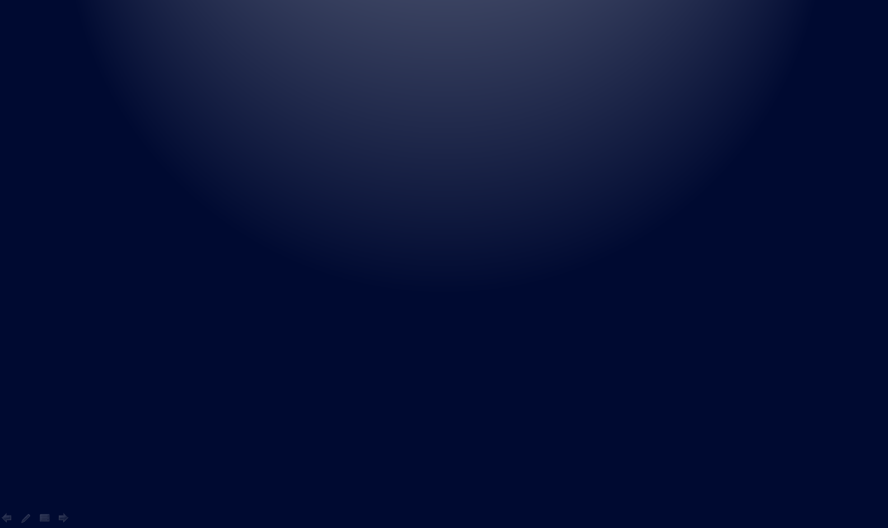
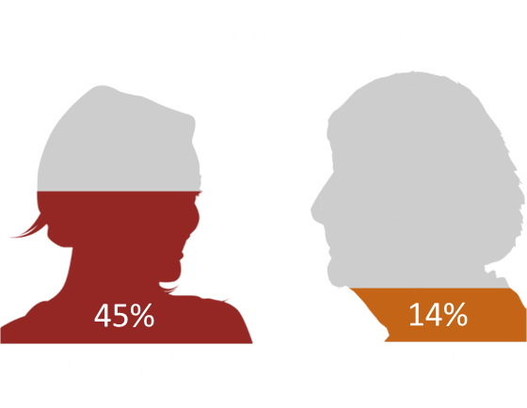
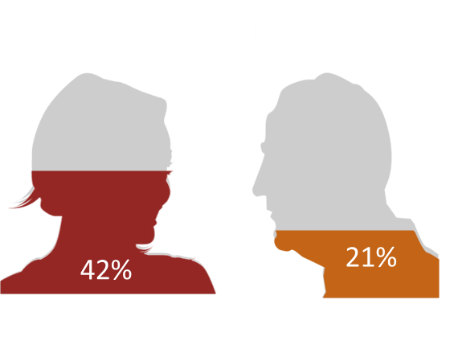
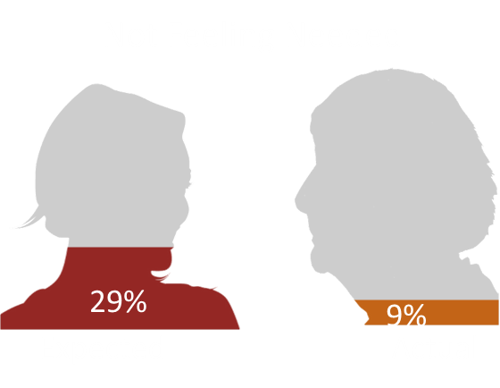
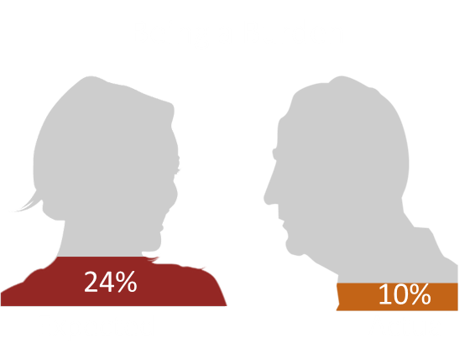
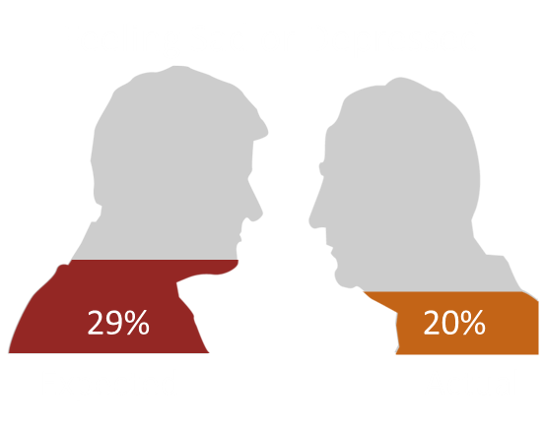
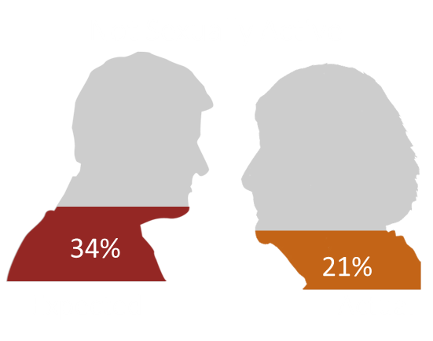
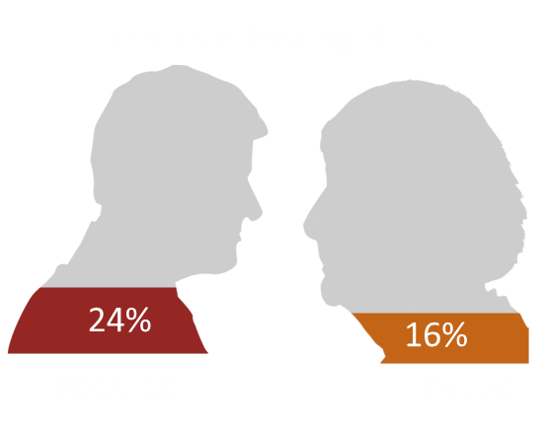
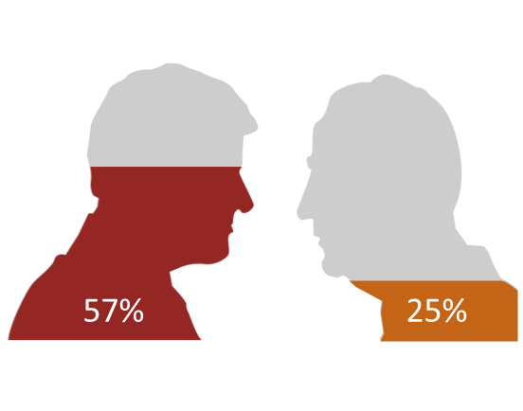
Aging Stereotypes:
Expected (18-64) vs. Actual (65+)
Actual experience
of older people is better than expected when they were younger
Notes:
**ANIMATION**
This slide illustrates the results of a survey about the expectations of growing old versus being old. Participants 18-64 were asked whether they expected to experience a particular aspect of growing old; this was compared to individuals 65+ who reported having actually experienced that symptom.
Move forward to reveal first picture
57% of younger individuals reported expecting to experience memory loss whereas 25% of older adults actually report memory loss.
Move forward to reveal second picture
45% of younger individuals reported expecting that they wouldn’t be able to drive whereas 14% of older adults actually report not being able to drive.
Move forward to reveal third picture
42% of younger individuals reported expecting to have a serious illness as an older adult, and 21% of older adults report actually being seriously ill.
Move forward to reveal fourth picture
34% of younger individuals expressed the expectation of not being sexually active past the age of 65 whereas 21% of older adults reported not being sexually active.
Move forward to reveal fifth picture
29% of younger individuals expected to feel sad or depressed, and 20% of older adults reported feeling sad or depressed.
Move forward to reveal sixth picture
29% of younger individuals expected to not feel needed whereas 9% of older adults reported not feeling needed.
Move forward to reveal seventh picture
24% of younger individuals expected to have trouble paying bills whereas 16% of older adults report trouble paying bills.
Move forward to reveal eighth picture
24% of younger individuals reported expecting to be a burden whereas 10% of older adults reported actually feeling like a burden.
Move forward to reveal the final picture
This survey demonstrates that getting older is not as bad as we typically think it might be. We have a lot of preconceived beliefs about what it means to age and be older.
REFERENCE:
Pew Research Center; Social & Demographic Trends. (2009). Growing Old in America: Expectations vs. Reality. Downloaded from: http://www.pewsocialtrends.org/2009/06/29/growing-old-in-america-expectations-vs-reality/

Slide 22
Health Care Must Adapt
Two factors – longer life span and baby boomers – will combine to double the 65 and older population by the year 2030.
The major cause of mortality has shifted from infectious disease and acute illness to chronic disease and degenerative illness
SOURCE: National Center for Chronic Disease Prevention and Health Promotion,
The State of Aging and Health in America, 2013
Notes:
Older adults will continue to increase as a percentage of the population. The aging process requires greater medical treatment as an individual gets older; add substance abuse and/or HIV to that, and there is now a greater need for focus on identification, patient education, and behavioral maintenance of on-going chronic illnesses that may be directly attributable to substance use or increased risk behaviors as a result of co-occurring mental/phyiscal health disorders.
REFERENCES:
National Center for Chronic Disease Prevention and Health Promotion. (2013). The State of Aging and Health in America. Centers for Disease Control and Prevention. Downloaded from: http://www.cdc.gov/aging/pdf/state-aging-health-in-america-2013.pdf

Slide 23
Older Adults and HIV
Notes:
INSTRUCTIONS
This slide serves as the transition from a discussion about the number of older adults in the US and California and what this means for healthcare moving forward to beginning a discussion specifically about older adults who are HIV-positive and what that means for engaging and challenges in developing treatment interventions for this population.

Slide 24
Older Adults and HIV
2012: 17% of new HIV cases in U.S. were older than 50
2014: Approximately 4.2 million HIV-positive individuals over age 50 worldwide (doubled over past 20 yrs)
2014: 35% of all PLWHA in U.S. were over 50
By 2020, > 50% of PLWHA will be over age 50
Contributing factors:
  Effectiveness of combination antiretroviral therapy (ART) in suppressing viral replication
  Delayed diagnosis of HIV due to clinically latent infection (virus is present but in very small quantities that do not produce symptoms, so individuals are unaware that they have it)
  Increase in HIV seroconversion by people over age 50
SOURCE: CDC HIV Surveillance Report, 2015
Notes:
In 2012, 17% of the new cases of HIV in the US were among individuals 50 and older and in 2014, 35% of all people living with HIV/AIDS(PLWHA) were over the age of 50. In 2014, approximately 4.2 million HIV-positive individuals worldwide were over the age of 50. This number has seen a significant increase, having doubled over the past 20 years, indicating that there is an aging of the existing HIV-positive population as well as continued new incidents of HIV among older adults. As a result of this, more than 50% of PLWHA in the US will be over the age of 50 by 2020.
The specific factors contributing to an extended lifespan among PLWHA include the increased effectiveness of combination antiretroviral therapies (ART) in suppressing the replication of the virus. There is also an aging of the PLWHA population as a result of delayed diagnosis of HIV due to clinically latent infection – a characteristic of the virus in which the virus remains present and able to reproduce but in very small quantities that are not sufficient to produce symptoms; thus individuals would be less likely to go to the doctor for screening or assessment as a result of not experiencing specific symptoms.
The last factor that contributes to an older PLWHA population is increased seroconversion in people over the age of 50 indicating a need for specific prevention programs targeted at this age group regarding information on new infections, behavior, knowledge and attitudes around HIV and AIDS.
Additional information for the Trainer(s)
Seroconversion is the period of time during which HIV antibodies develop and become detectable. This process generally takes place within a few weeks of initial infection and can be often, but not always, be accompanied by flu-like symptoms including fever, rash, muscle aches, and swollen lymph nodes. These symptoms in-and-of-themselves, however, are not a reliable way to identify seroconversion or to diagnose HIV infection.
REFERENCE:
HIV Surveillance Report, Vol. 25. (2015). Diagnoses of HIV Infection in the United States and Dependent Areas, 2013. Centers for Disease Control and Preventions. Downloaded from: http://www.cdc.gov/hiv/pdf/g-l/hiv_surveillance_report_vol_25.pdf
Mahy, M., Autenrieth, C.S., Stanecki, K., & Wynd, S. (2014). Increasing trends in HIV prevalence among people aged 50 years and older: evidence from the estimates and survey data. AIDS, 28(4), S453-S459.
Weintrob, A.C., et al. (2008). Increasing Age at HIV Seroconversion From 18 to 40 Years is Associated With Favorable Virologic and Immunologic Responses to HAART. Journal of Acquired Immune Deficiency Syndromes, 49(1), 40-47.

Slide 25
HIV Incidence: Increasing in 50 & Over
Percent Change from 2013-2014
282 new cases in California among older adults between June 2013 and June 2014
SOURCE: CA Dept of Public Health, Office of AIDS, 2014
Notes:
The percentage of new HIV cases in California among older adults aged 50 and older is increasing. Between June 2013 and June 2014, there were 282 new cases of HIV in California among older adults. This represents an increase of 4.7% in the number of total HIV cases during this time period for the 50+ age group. Compared to other age ranges, the 50+ age group had the highest percentage increase, equal to the increase in the 13-19 year old age group.
REFERENCE:
California Department of Public Health, Office of AIDS. (2014). California HIV/AIDS Surveillance Statistical Reports. Downloaded from: http://www.cdph.ca.gov/data/statistics/Pages/OAHIVAIDSStatistics.aspx

Slide 26
Older Adults and HIV
Delayed HIV diagnosis common in older individuals due to lack of recognition of risk factors
Older age at time of diagnosis increases risk of opportunistic infections and progression to AIDS
For instance: NYC (2013) progression to AIDS at the time of HIV diagnosis in people over age 50 almost double those younger than 50 (33% vs. 17%)
Older people generally respond well to ART treatment and may achieve higher rates of viral suppression than younger people
Notes:
Another factor that deserves specific focus is the way in which older adults recognize risk factors and have been educated on risk behaviors that could contribute to infection. Delayed identification or diagnosis of HIV that is common in older individuals is due to the lack of recognition of risk factors in the older adult population. Older age at time of diagnosis also increases the risk of other opportunistic infections (infections that occur more frequently and impact the individual more severely as a result of the weakened immune system) and progression to AIDS.
One study from the New York City Department of Health and Mental Hygiene noted that the progression from HIV to AIDS among adults 50 and older was almost double that of individuals younger than 50. However, research shows that older people generally respond well to antiretroviral therapy once the virus is detected and diagnosed.
REFERENCE:
Collaboration of Observational HIV Epidemiological Research Europe (COHERE) Study Group. (2008) Response to combination antiretroviral therapy: variation by age. AIDS, 22, 1463-1473.
Gras, L., et al. (2007). CD4 cell counts of 800 cells/mm3 or greater after 7 years of highly active antiretroviral therapy are feasible in most patients starting with 350 cells/mm3 or greater. Journal of Acquired Immune Deficiency Syndromes, 45, 183-192.
New York City Department of Health and Mental Hygiene. (2013). HIV Surveillance Annual Report, 2012. Downloaded from: www.nyc.gov/html/doh/downloads/pdf/dires/surveillance-report-dec-2013.pdf
Viard, J.P., et al.; EuroSIDA Study Group. (2001). Influence of age on CD4 cell recovery in human immunodeficiency virus-infected patients receiving highly active antiretroviral therapy: evidence from the EuroSIDA study. Journal of Infectious Diseases, 183, 1290-1294.

Slide 27
Older Adults and HIV
However, CD4 recovery may be less complete than in younger people
CD4 lower in HIV-infected young adults and older adults
HIV-infected and non-HIV-infected older adults have lower T cells than younger individuals
HIV-infected older adults have the lowest counts of any group
Increasing age is associated with diminished T cell functioning
This may explain why older HIV+ adults are more prone to and require longer recovery time from illness leading to increased medical needs and costs
SOURCE: Nguyen, Holodniy. 2008.
Notes:
CD4 cells (or T cells) are a type of white blood cell that is involved in protecting the body from infection. The number of CD4 cells is one of the ways to determine whether an infected individual has progressed to having AIDS. While older adults respond just as well to ART treatments as younger individuals, CD4 recovery can be lower than younger individuals. Three aspects of CD4 counts and the impact on older adults to consider are:
1. CD4 counts are lower in HIV-infected older adults compared to their younger HIV-infected counterparts.
2. Older adults have lower CD4 cell counts (regardless of HIV infection or not) than younger individuals.
3. HIV-infected older adults have the lowest CD4 cell counts of any infected or non-infected age group.
In addition to lower cell counts overall, increasing age is associated with a decrease in functioning of CD4 cells and ability to fight off infections. In summary, the decreased CD4 cell count and functioning could be an explanation as to why older HIV-positive adults are more prone to becoming ill and requiring longer recovery times which lead to increased medical needs and costs.
REFERENCE:
Nguyen, N., Holodniy, M. (2008). HIV infection in the elderly. Clinical Interventions in Aging, 3(3), 453-472.

Slide 28
Factors Related to Increased HIV Incidence Among Older Adults
92% of older adults consider sex an important part of their life
75% (65-74) report being sexually active
27% report condom use
60% of older adults reported no screening for STIs within last year
Rates of certain STIs (syphilis, chlamydia) have increased as much as 87%
SOURCE: CDC, 2008; National Library of Medicine, 2014
Notes:
**ANIMATION**
This slide animates in two parts. The first part highlights specific attitudes that older adults have towards sex. The second part will dim the first two bullet points and introduce the three that identify sexual education and identification of symptoms/riskiness among older adults. This slide can be tied back to Slide 12 in regards to misconceptions that older adults have about risky behavior and how STIs are transmitted, further illustrating the need for patient education as a key component in treatment.
Click to reveal the first two bullet points
92% of older adults consider sex to be an important part of their lives and 75% of individuals between the ages of 65 and 74 report regular sexual activity.
Click to reveal the last three bullet points
Of the individuals who identified as being sexually active, only 27% reported condom use. 60% of older adults report not having been screened for any sexually transmitted infections (STIs) within the last year while rates of certain STIs like syphilis and chlamydia have risen as much as 87% among older adults.

Slide 29
Factors Related to Increased HIV Incidence Among Older Adults
Many older adults have same risk factors for HIV infection that younger persons have
Many older adults are sexually active but may not perceive themselves to be at risk, and therefore don’t practice safer sex
Older women may be especially at risk because of age-related vaginal thinning and risk of tears
HIV transmission through injection accounts for more than 16% of cases among adults 50+
SOURCE: CDC, 2008; National Library of Medicine, 2014
Notes:
The risk of contracting HIV does not decrease with age and many older adults have, in fact, the same risk factors for HIV infection as younger individuals. Older individuals remain sexually active but may not perceive themselves as being at risk for sexually transmitted infections and therefore don’t practice safer sex. Older women especially may be at risk of infection as a result of biological changes including vaginal thinning and reduced lubrication, increasing the risk of tears.
HIV transmission through the use of injection drugs accounts for more than 16% of cases among adults 50+ indicating that older adults are continuing to use intravenous drugs.

Slide 30
Factors Related to Increased HIV Incidence Among Older Adults
Very little HIV prevention education is targeted at older adults
Many older people are recently single through divorce or death, so sexual activity outside of relationship is new to them again
Older, racial/ethnic minority individuals may face additional discrimination and stigma that can lead to later testing, diagnosis
SOURCE: CDC, 2008; National Library of Medicine, 2014
Notes:
Very little education is currently targeted specifically at older adults. Combined with information available and discussed when older adults were younger about how to practice safe sex, risky drug use, and how HIV is transmitted all contribute to older adults being at a disadvantage for receiving the most up-to-date information about reducing risky behavior. Specific to racial/ethnic minorities: these individuals may face certain discrimination and/or stigma that has a cultural basis that can lead to later testing and diagnosis. Additionally, older people are recently single as a result of divorce or death, so sexual activity outside of the relationship is new again for them.

Slide 31
Factors Related to Increased HIV Incidence Among Older Adults
Approx 2/3 of new HIV/AIDS cases in older individuals are among MSM
However, higher proportion of older individuals report “unknown” source of infection than in younger age groups
Fear of stigma likely leads to non-disclosure of sexual practices/risk behaviors to healthcare providers
SOURCE: HIV in Older Adults: A Quick Reference Guide for HIV Primary Care Clinicians, 2014.
Notes:
Considering the rates of HIV infection among racial/ethnic minorities and other groups that may be disproportionately affected by health disparities, research shows that 2/3 of new HIV/AIDS cases in older individuals are among men who have sex with men (MSM). A higher proportion of older adults compared to younger individuals report an unknown source of infection, possibly indicating perceived sociocultural stigma around sexual practices or other risky behavior. This fear of stigma also contributes to non-disclosure of sexual practices to healthcare providers.
REFERENCE:
McGowan, J.P. (2014). HIV in Older Adults: A Quick reference guide for HIV Primary Care Clinicians. Downloaded from: http://www.medscape.com/viewarticle/836954

Slide 32
Factors Related to Increased HIV Incidence Among Older Adults: Stigma
Internalized HIV-related stigma has significant negative effects on mental health, particularly when combined with internalized homophobia
May be significantly greater for older individuals, i.e. “I should have known better at my age”
Substance-related coping significantly increases suicidal ideation for LGBT individuals who have disclosed HIV status to family/friends
SOURCE: Cramer et al, 2015
Notes:
Internalized stigma resulting from upbringing, cultural norms and expectations and education regarding risky behaviors can significantly impact mental health, especially when combined with internalized homophobia. Stigma and shame can be significantly greater for older adults as a result of feeling like “I should have known better for my age.” Research also indicates that, among LGBT individuals who have disclosed HIV status to friends and family, substance use as a means of coping with emotional distress significantly increases suicidal ideation.
REFERENCE:
Cramer, R.J., et al. (2015). Substance-related coping, HIV-related factors, and mental health among an HIV-positive sexual minority community sample. BMJ Open, 3(2), e001928.

Slide 33

Substance Misuse and
Older Adults
Notes:
INSTRUCTIONS
This slide serves as a transition from discussing prevalence and disease characteristics of HIV/AIDS among older adults to identifying problems with substance use among older adults, building on the fact that substance use presents a clear risk factor for contracting HIV (through intravenous drug use) or increasing the potential for unprotected sex and other risky behaviors.

Slide 34
An Invisible Epidemic
Alcohol abuse and prescription drug abuse among adults 60+ is one of the fastest growing health problems in the U.S.
Substance abuse affects up to 17% of older adults.
Symptoms often mimic, are masked by, or are misinterpreted as the aging process
Notes:
Consider that alcohol abuse and prescription drug abuse among older adults, specifically those individuals 60+ is one of the fastest growing health problems in the United States, with substance abuse affecting up to 17% of older adults. The difficulty in identifying appropriate care for individuals who have not disclosed use is that symptoms of substance use are often masked by the aging process. In consideration of ageism and biases that providers may unconsciously hold, substance use symptoms can also be misinterpreted as part of the aging process.
Additional information for the Trainer(s)
SAMHSA’s Treatment Improvement Protocol (referenced below) for working with older adults identifies this “hidden epidemic” as an area needing substantial more focus. Identification, diagnosis, treatment, and recognition of the prevalence of older adult substance abuse continue to be outpaced by increasing substance abuse among the elderly. Medical and behavioral disorders common in this population that may look similar include diabetes, dementia, and depression. Additionally, older adults typically do not participate in clinical trials of new medications.
REFERENCE:
Center for Substance Abuse Treatment. (2012). Substance Abuse Among Older Adults. Treatment Improvement Protocol Series, No. 26. HHS Publication No. (SMA) 12-3918. Rockville, MD: Substance Abuse and Mental Health Services Administration.

Slide 35
Substance Abuse Among Older Adults
4.8 million adults aged 50 and older have used an illicit drug in the past year (5.2% of population)
  Marijuana is the most commonly used substance, followed by nonmedical use of prescription medications
Prevalence of illicit drug use was higher among 50 to 59 year olds than those 60 and older
Publicly-funded treatment admissions for people aged 50 and older nearly doubled between 1992 and 2008 (from 6.6% to 12.0%)
SOURCE: Reardon, C. (2012).
Notes:
Among older adults 50 and older, 5.2% report past-year illicit drug use – approximately 4.8 million adults. Among drugs used, they reported marijuana being the most commonly used illicit drug (no different than their younger peers), following by nonmedical use of prescription medications. The age group of 50-to-59 year-olds also demonstrated more illicit drug use than those 60 and older. Between 1992 and 2008, publicly-funded treatment admissions for adults 50 and older nearly doubled from 6.6% to 12.0%. These numbers indicate that “the face” of substance use is getting older consistent with population changes as previously mentioned.
REFERENCE:
Reardon, C. (2012). The Changing Face of Older Adult Substance Abuse. Social Work Today, 12, 8. Downloaded from: http://www.socialworktoday.com/archive/012312p8.shtml

Slide 36
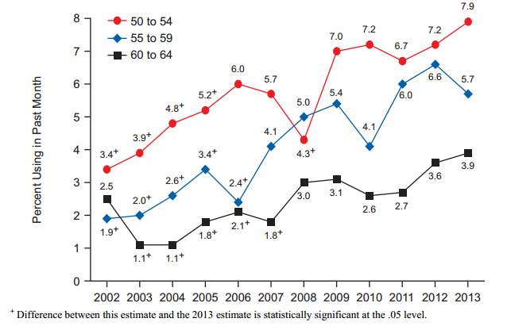
Past Month Illicit Drug Use among Adults Aged 50 to 64: 2002-2013
SOURCE: SAMHSA, NSDUH (2013 results).
Notes:
According to data from the 2013 National Survey on Drug Use and Health (NSDUH), past month older adult substance use is increasing among the 50-54 year old age group and the 60-to-64 age group. The 50-54 age group, represented by the red line, is at its highest point since 2002. Among the other two groups, past month use continues to trend higher than 2002 levels.

Slide 37
Past Month Substance Use – Individuals Under Age 50 vs. 50 and Older
Percent
SOURCE: SAMHSA, NSDUH (2013 results).
Notes:
The NSDUH results displayed on this graph demonstrate that individuals 50 and older are much more like to engage in past-month alcohol use as compared to individuals under the age of 50. However, younger individuals are more likely to binge drink and use illicit substances when compared to adults 50 and older.

Slide 38
Marijuana Use among Older Adults
8.1% of adults aged 50 to 59 and 3.1% of adults 60 and older used marijuana in 2013 (NSDUH)
  Marijuana use in adults has steadily increased in both age groups since 2002
Between 2004 and 2010, the number of 55-64 year olds who went to an emergency room for a marijuana-related reason rose from 3,671 to 14,019 (DAWN)
SOURCE: SAMHSA, NSDUH (2013 results) and DAWN (2011 results).
Notes:
According to the 2013 NSDUH, 8.1% of adults aged 50 to 59 used marijuana in 2013. Among the 60 and older age group, 3.1% reported marijuana use in 2013. Marijuana use numbers among both age groups have steadily increased since 2002 and continue to do so.
There has also been a documented increase in emergency room admissions for marijuana-related reasons among older adults 55-64. Between 2004 and 2010, this number rose from 3,671 to 14,019 according to Drug Abuse Warning Network (DAWN).

Slide 39
Trends in Treatment Admissions among Older Adults
Alcohol is the most common primary substance of abuse among older adult treatment admissions
  Proportion declined from 84.6% in 1992 to 59.9% in 2008
Proportion of older adult admissions for primary heroin abuse more than doubled between 1992 to 2008 (from 7.2% to 16%)
Proportion of older adult admissions for primary cocaine abuse quadrupled (2.8% to 11.4%)
SOURCE: Reardon, C. (2012).
Notes:
Alcohol is the most common primary substance of abuse identified among older adult treatment admissions. Overall, the percentage of older adult treatment admissions reporting alcohol as the primary substance of abuse has decreased from 84.6% to 59.9% between 1992 and 2008. This indicates that other substances or illicit drugs are increasing as the primary substance of abuse among older adults. In fact, treatment admissions for primary heroin abuse and primary cocaine abuse support this indicator. Between 1992 and 2008, treatment admissions among older adults for primary heroin abuse more than doubled from 7.2% to 16%. For this same time period and age range, cocaine abuse has quadrupled from 2.8% to 11.4%

Slide 40

Alcohol
Notes:
INSTRUCTIONS
This slide serves to move from discussions of treatment admissions and the number of older adults using substances to begin discussing co-occurrence of substance use and the specific recommendations for alcohol use, including research around potential medical and mental health impairments unique to an aging population.

Slide 41
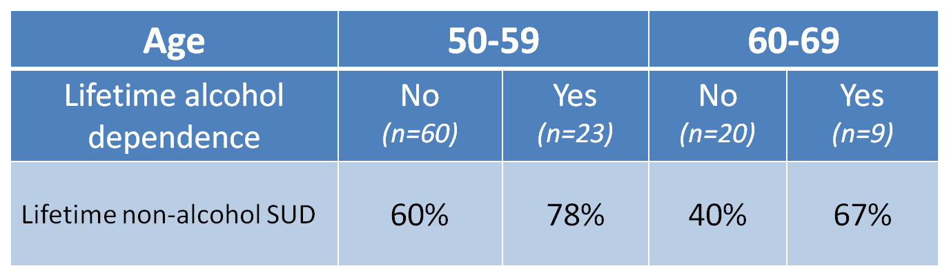
HIV and Substance Use Disorders
Drug Use by Age and
Alcohol Dependence (n=112)
SOURCE: Gongvatana et al, 2014
Notes:
Only very recently has alcohol use and co-occurrence of other substance use in older, HIV-positive adults been begun to be looked at – in this study from 2014, in a sample of 112 HIV+ individuals age 50-69: among both older age groups, there is a high prevalence lifetime non-alcohol substance use disorder if an individual had alcohol dependence at some point in his/her life. Among individuals who did not have lifetime alcohol dependence, the occurrence of lifetime non-alcohol substance use disorder was a bit lower, but still 60% for individuals 50-59 and 40% for individuals 60-69. Overall, older adults with HIV are at risk of developing at least one substance use disorder during their lifetime.
REFERENCE:
Gongvatana, A., et al. (2014). A history of alcohol dependence augments HIV-associated neurocognitive deficits in persons aged 60 and older. Journal of Neurovirology, (20)5, 505-513.

Slide 42





Drinking Guidelines
Older Adult Drinking Guidelines
Men and Women >65: No more than 3 drinks
on any day and 7 drinks per week
NIAAA considers 1 drink per day to be the maximum for “moderate” use
Men: No more than 4 drinks on any day and 14 drinks per week
Women: No more than 3 drinks on any day and 7 drinks per week
NIAAA, 2011
Beer Wine Fortified Wine Liquor
12 oz 5 oz 3.5 oz 1.5 oz
Notes:
Drinking Guidelines
[Slide 5] Special concerns arise when developing alcohol consumption guidelines for the older adult population. Compared with younger people, older adults have an increased sensitivity to alcohol, as well as to over-the-counter and prescription medications. There is an age-related decrease in lean body mass versus total volume of fat. The resultant decrease in total body volume increases the circulating distribution of alcohol and other mood-altering chemicals in the body. Liver enzymes that metabolize alcohol and certain other drugs become less efficient with age. Central nervous system sensitivity increases with age.
As stated before, the potential interaction of medications and alcohol is a particular concern in this age group. For some individuals, ANY alcohol use with specific over-the-counter or prescription medications can be problematic. Because of the age-related changes in how alcohol is metabolized, and the potential interactions between medications and alcohol, alcohol use recommendations for older adults are lower than those for adults under 65. For example, the National Institute on Alcohol Abuse and Alcoholism (NIAAA, 1995b) and the CSAT Treatment Improvement Protocol (TIP) on older adults (Blow, CSAT, 1998b) recommend that persons age 65 and older consume no more than one standard drink per day or seven standard drinks per week (Dufour & Fuller, 1995; Dietary Guidelines Advisory Committee, 2000, page 39). In addition, older adults should not consume more than 2 standard drinks on any drinking day. It is recommended that the limit for older women should be slightly less than one standard drink per day.
**ANIMATION**
This slide animates in four parts. The first half of the slide presents information related to general drinking guidelines for men and women. The subsequent animations will reveal the drinking guidelines specifically for men and women older than 65. The information is based on the recommended drinking guidelines of the National Institute on Alcohol Abuse and Alcoholism (NIAAA).
Click to reveal the first bullet point
For men, the NIAAA recommend no more than 4 drinks on any day and nor more than 14 drinks per week.
Click to reveal the next bullet point
For women, the NIAAA recommendation is to consume no more than 3 drinks on any day and no more than 7 drinks per week.
Click to reveal the title “Older Adult Drinking Guidelines”
The guidelines are slightly different for older adults due to physiological changes and changes in the way alcohol is metabolized in older adults. For those individuals older than 65, the NIAAA recommends that both men and women have no more than 3 drinks on any day and no more than 7 drinks per week. They go on to say that if the individual is taking medications or has a health condition, drinking may not be indicated.
Click to reveal the last bullet point
The NIAAA goes on to say that 1 drink per day should be the maximum amount consumed to consider as “moderate” use for older adults.
Additional information for the Trainer(s)
As noted by the NIH, these guidelines are identified for adults who are healthy and do not take any medications. Taking medications or having a health condition may mean reducing drinking or not drinking at all.
People have different personal definitions of what exactly constitutes an alcoholic “drink.” The National Institute on Alcohol Abuse and Alcoholism has developed a definition of a standard drink. A standard drink can be a 12 ounce beer, 8-9 ounces of malt liquor, 5 ounces of wine, 3-4 ounces of fortified wine, 2-3 ounces of cordial, 1.5 ounces of brandy, or 1.5 ounces of spirits such as vodka, gin, or scotch. So, a drink for one person may be a “40-ouncer” of beer, which, if you use NIAAA’s definition of a standard drink, would equal 3 1/3 standard drinks. It is very important for alcohol dependent clients to understand what is meant by “a drink” when you are assessing the extent of their alcohol problem.

Slide 43
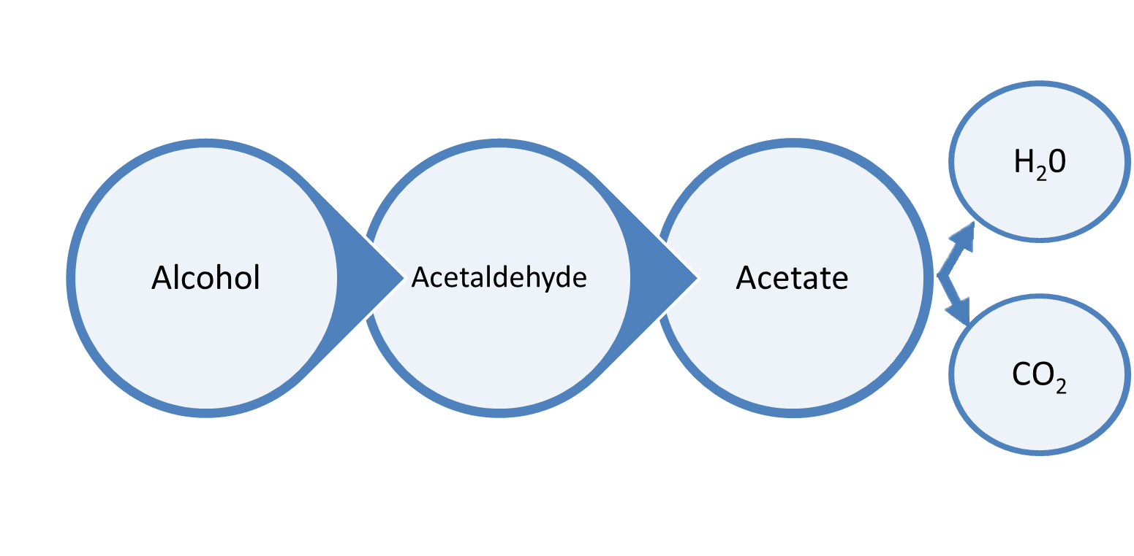
Older Adults and Alcohol
Decreased body water, combined with a decrease in alcohol dehydrogenase results in higher concentrations of alcohol in the blood that are eliminated more slowly due to reduced blood flow to the liver and kidney function decline as aging occurs
Alcohol Dehydrogenase
Acetaldehyde Dehydrogenase
Notes:
43
This is an illustration of the process for breaking down alcohol and the impact on older adults as a result in changes in metabolic functioning and overall physiological changes. As an individual ages, there are lower overall amounts of water in the body and reduced blood flow to the liver and kidneys which contribute to declines in those organs’ abilities to process alcohol.
When an individual drinks alcohol, it is broken down in three stages. First, the enzyme Alcohol Dehydrogenase converts alcohol into Acetaldehyde. Acetaldehyde is actually a toxic compound and therefore must be broken down further and eliminated.
This occurs through the enzyme Acetaldehyde Dehydrogenase. It converts that acetaldehyde into acetate. Finally, Acetate is converted into water and carbon dioxide and eliminated from the body.

Slide 44
Aging, Drinking & Consequences
Higher BAC from a given dose
More impairment at a given BAC
Interactive effects of alcohol, chronic illness and medication
Decrease in lean body mass, bone and muscle, increase in percentage of body fat with aging
Notes:
Given that older adults are recommended to drink less and the previous slide identified the physiological mechanisms that contribute to reduced efficiency in processing alcohol, what are the consequences of drinking for older adults? Older adults have a higher BAC from a given does which can result in feeling more intoxicated as well as potential legal problems resulting from DUIs.
There is also the potential for interactions between medications, chronic illnesses, and alcohol. Use of alcohol can reduce the efficacy of prescription medications and exacerbate chronic illness symptoms. Older adults also experience decreases in lean body mass, bone and muscle as they age which also increases the risk of debilitating falls when intoxicated. Older adults also have increases in percentage of body fat with aging which can also put older adults at risk of chronic illnesses that are exacerbated by alcohol use (i.e. diabetes).

Slide 45
Drinking in Older Adults
Results of Three Nationally-Representative Surveys
Alcohol Use | Men | Women
None | 49-60% | 63-72%
≤ 1 drink/day | 27-39% | 22-32%
> 1 drink/day | 9-10% | 2-3%
SOURCE: Breslow et al, 2003
Notes:
The following table presents the results of three nationally-representative surveys of alcohol consumption among men and women aged 65 or older. Based on the table, men consume more alcohol than women regardless of whether the amounts consumed are in the “moderate” range or higher.
REFERENCE:
Breslow, R.A., Faden, V.B., & Smothers, B. (2003). Alcohol consumption by elderly Americans. Journal of Studies on Alcohol, 65(6), 884-892.

Slide 46
Data from NESARC
8205 adults aged 65 and older
Almost 75% reported ever using alcohol
Almost 50% reported using alcohol in previous 12 months
Alcohol use in past year drinkers:
  67.2% light drinkers (≤ 3 drinks/week)
  22.2% moderate drinkers (4-14 drinks/week for men and 4-7 drinks/week for women)
  10.7% were heavy drinkers (> 14 drinks/week for men and > 7 drinks/week for women)
SOURCE: Moore et al, 2009
Notes:
The data presented on this slide is drinking and alcohol consumption from the National Epidemiological Study of Alcohol and Related Conditions. The study looked at 8,205 adults aged 65 or older. Among those individuals, 75% reported any use of alcohol, 50% reported past year use of alcohol. Of the individuals who identified as past year drinkers, 67% were light drinkers, 22% were moderate drinkers, and 11% were heavy drinkers according to the NIAAA guidelines for drinking.

Slide 47
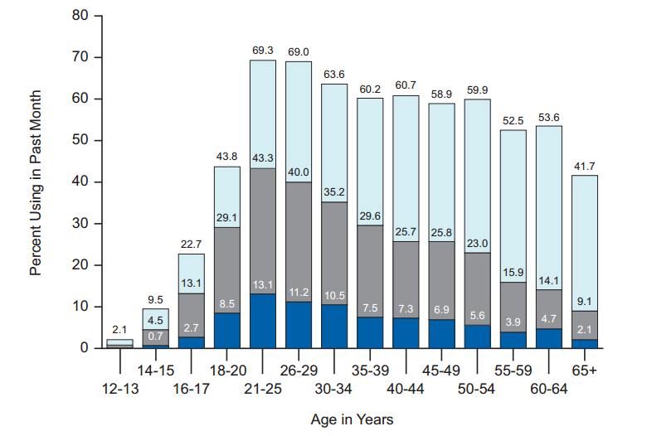
Current, Binge, and Heavy Alcohol Use among Persons aged 12 and older: U.S., 2013
SOURCE: SAMHSA, National Survey on Drug Use and Health, 2013 findings.
Notes:
If we look at binge drinking and “heavy drinking”, we see a steady increase from early teens up to mid-20’s. After mid-20’s, however, we see a steady decline in binge and heavy drinking. ANY past-30 days drinking remains fairly constant up to age 65, and then drops to 41.7%, but this still represents a great many people, some of whom are likely under-reporting their level of drinking.
Slightly more than half (52.2 percent) of Americans aged 12 or older reported being current drinkers of alcohol in the 2013 survey, which was similar to the rate in 2012 (52.1 percent). This translates to an estimated 136.9 million current drinkers in 2013. In 2013, heavy drinking was reported by 6.3 percent of the population aged 12 or older, or 16.5 million people. This percentage was similar to the rate of heavy drinking in 2012 (6.5 percent).
Additional information for Trainer(s)
The following are NSUDH definitions for heavy alcohol use and binge alcohol use:
Binge alcohol use = Five (5) or more drinks on the same occasion (at the same time or within a couple of hours of each other) on at least one day in the past 30 days.
Heavy alcohol use = Binge drinking on five or more days in the past 30.
An increase in depressive symptoms was observed in older adults when drinking exceeded two drinks per day.

Slide 48
Older Adults: Living Situations
SOURCE: California Department of Public Health, California HIV/AIDS Surveillance Statistical Reports, 2014
Notes:
This slide shows the estimated numbers of older adults who are currently living the in United States, broken down by gender and living situation. It is helpful to understand the demographic breakdowns as they relate to risk factors for drinking that will be discussed on subsequent slides. There are more women than men and more women live alone than older men.

Slide 49

Older Adults and Alcohol
More frequent drinking associated with:
  Being married
  Not living alone
  Having a larger social network
  Frequent participation
  in activities in and
  out of the home
Notes:
More frequent drinking is associated with several different factors: being married, not living along, having a larger social network, and more frequent participation in activities in and out of the home.

Slide 50

Older Adults and Alcohol
Higher volume drinking associated with:
  Lower family satisfaction
  Depression
  Higher perceived stressfulness in life
  Lower sense of coherence
  Not being married
  Living alone
Notes:
Though individuals who are married and engaged in more social activities drink more frequently, individuals who live alone are more likely to drink in higher volumes. Higher volume drinking is also associated with lower family satisfaction, higher rates of depression, higher perceived stressfulness in life, lower sense of coherence, and not being married.
REFERENCE:
Graham, K. & Schmidt, G. (1999). Alcohol use and psychosocial well-being among older adults. Journal of Studies on Alcohol and Drugs, 60(3), 345-351.

Slide 51
Older Adults and Alcohol
Older women more likely to have alcohol problem:
  Have had a problem-drinking spouse
  Widowed
  Experience depression
  Injured due to falls
Those who self-medicate are more likely to identify as lonely or report lower life satisfaction
Notes:
Older women who are more likely to have problems with alcohol have had a problem-drinking spouse; are widowed; experience depression; are more likely to be injured due to falls. Similarly, individuals who self-medicate using alcohol or other drugs are more likely to identify as lonely or report lower life satisfaction.

Slide 52
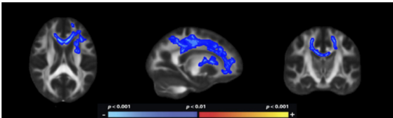
Lasting damage due to chronic alcoholism after 50
SOURCE: Fortier, et al. 2014
Notes:
Lasting impacts in white matter deterioration were noted with continued use after the age of 50. This age was identified as a “critical threshold” by researchers and continued drinking after this threshold represented deterioration in the brain’s ability to heal from alcohol-induced damage. This damage could impair judgment, reasoning, planning. Consider also that damage to this region of the brain impairs acquisition of new skills or changes in behavior and what the implications are for treatment. Combined with decreased control and judgment, chances of relapse are strong.
REFERENCE:
Fortier, C.B. et al. (2014) Widespread Effects of Alcohol on White Matter Microstructure. Alcoholism: Clinical and Experimental Research, 38(12), 2925-2933.

Slide 53
Older Adults and Alcohol
Medical Concerns
Heavy drinking associated with increased injuries due to falls
Leading risk factor in the development of cancers of the mouth, neck, and head; as well as coronary artery disease and stroke
Heart disease, cancer, and stroke are the three leading causes of death among individuals 65 & older (Cummings, Cooper & Cassie, 2008)
Later life acute and chronic illnesses can be prevented or managed through lifestyle alterations
Notes:
A number of medical concerns for older adults are associated with drinking. This includes an increase in injuries due to falls when engaged in heavy drinking. Alcohol consumption is also the leading cause of the development of cancers of the mouth, neck , and head; as well as coronary artery disease and stroke. These chronic illnesses – heart diseease, cancer, and stroke – are the three leading causes of death among individuals 65 and older. However, these illnesses and the risk factors that preceded them can be managed through behavioral intervention and alterations to lifestyle.
REFERENCE:
Cummings, S.M, Cooper, R.L., Cassie, K.M. (2009). Motivational Interviewing to Affect Behavioral Change in Older Adults. Research on Social Work Practice, 19, 195-204.

Slide 54
Conditions that may be caused or worsened by alcohol use
Lip and oropharyngeal cancer
Esophogeal varices and cancer
Laryngeal cancer
Liver cirrhosis & cancer
Gastro-esophageal hemorrhage
Acute and chronic pancreatitis
Female breast cancer
Epilepsy
Hypertension
Cardiac arrhythmias
Hemorrhagic stroke
Psoriasis
Depression/suicide
Cognitive impairment
Alcohol use disorders
Notes:
INSTRUCTIONS
Highlight the multidirectional pathways for certain disorders like depression. Example: an individual who is using alcohol to cope with feelings of sadness or depression will end up experiencing more profound depressive symptoms when not using, requiring the need for more use in order to reduce the impact of feelings of depression. This in turn could lead to substantial physical health impairments including those listed on this slide.

Slide 55
General Alcohol-Medication Interactions
Increased or decreased drug metabolism
  Sedatives, warfarin, phenytoin, narcotics
Interference with effectiveness of drugs
  Drugs for HTN, gout, ulcer disease, GERD, depression, insomnia
Exacerbation of side effects
  Hypotension (nitrates), sedation (narcotics, sedatives), GI bleeding (NSAIDs, ASA)
SOURCE: Weathermon et al, 1999
Notes:
Alcohol interacts with specific medications and can affect the efficacy of prescribed medications. Specifically, it can increase or decrease the way in which a drug is metabolized, which could affect its functioning. This includes sedatives, warfarin, phenytoin, and narcotics. Alcohol will also affect the effectiveness of drugs for hypertension, gout, ulcer disease, gastroesophageal reflux disease, depression, and insomnia. Alcohol will also make the side effects worse for nitrates (used to treat coronary artery disease), narcotics and benzodiazepines (sedation), and nonsteroidal anti-inflammatory drugs and aspirin (gastrointestinal bleeding).
REFERENCE:
Weathermon, R., & Crabb, D.W. (1999). Alcohol and Medication Interactions. Alcohol Research & Health, 23(1), 40-54.

Slide 56
PLWHA and Alcohol
Nearly 50% of PLWHA have lifetime alcohol use disorder
Approx 8% report current heavy drinking (approx double general population rate)
Associated with:*
  Poor mental health functioning
  Increased odds of suicide
  Increased risk of accidental or recurrent falls
  Increased mortality
Notes:
Nearly 50% of people living with HIV/AIDS (PLWHA) have had an alcohol use disorder during their lifetime. Approximately 8% of PLWHA report current heavy drinking which is approximately double the rates in the general population. This increase alcohol consumption in PLWHA is associated with poor mental health functioning, increased odds of suicide, increased risk of accidental or recurrent falls and increased mortality.
REFERENCES:
Byrd, D.A., et al. (2013). Isolating Cognitive and Neurologic HIV Effects in Substance-Dependent, Confounded Cohorts: A Pilot Study. Journal of the International Neuropsychological Society, 19(4), 463-473.
Halvan, F.H., et al. (2015). The prevalence of alcohol consumption and heavy drinking among people with HIV in the United States: results from the HIV Cost and Service Utilization Study. Journal of Studies on Alcohol, 63(2), 179-186.
Sacco, P. Bucholz, K.K, & Spitznagel, E.L. (2009). Alcohol Use Among Older Adults in the National Epidemiologic Survey on Alcohol and Related Conditions: A Latent Class Analysis. Journal of Studies on Alcohol and Drugs, 70(6), 829-838.

Slide 57
Antiretroviral Medication and Alcohol/Drug Interactions
Alcohol and most illicit drugs are metabolized by the same liver enzymes (CYP450) as many HIV medications i.e. Norvir, Viracept, Kaletra, Sustiva, Atripla, Complera, & Stribild, which can lead to significant adverse interactions between them
Other medications, i.e. Combivir, Truvada are metabolized by different liver enzymes, and are less vulnerable to interactions with psychotropic medications or alcohol/drugs
Significant for ongoing treatment, PEP, and PrEP
SOURCE: Thompson, 2006
Notes:
Alcohol and other illicit drugs are metabolized in the liver by the same enzymes (CYP450) that metabolize many HIV medications (such as Norvir, Viracept, Kaletra, Sustiva, Atripla, Complera, and Stribild). The same metabolization pathway can lead to significant adverse reactions between alcohol/drugs and the HIV medications, leading to decreased medication efficacy, liver functioning, and immune functioning.
However, other medications such as Combivir and Truvada are metabolized by different liver enzymes and are less vulnerable to interactions with psychotropic medications or alcohol/drugs. This presents an opportunity for treatment co-occurring disorders in PLWHA without as great a risk to liver functioning and is significant in ongoing treatment as well as post-exposure prophylaxis and pre-exposure prophylaxis.
REFERENCE:
Thompson, A., Silverman, B., Dzeng, L. & Treisman, G. (2006). Psychotropic Medications and HIV. Clinical Infections Diseases, 42(9), 1305-1310.

Slide 58
Antiretroviral Medication and Alcohol/Drug Interactions
Studies of Simian Immunodeficiency Disease (SIV) -infected rhesus monkeys has shown that chronic use of alcohol:
  Accelerates disease progression to end-stage
  Increases elevations of viral load in lungs during bacterial infections
  Decreases skeletal muscle functional capacity
  Increases viral load in cerebrospinal fluid
  Accelerates cognitive impairment and neurobehavioral deficits
  Accentuates wasting at end-stage disease
SOURCE: Molina, 2015
Notes:
Studies using rhesus monkeys infected with Simian Immunodeficiency Disease (SIV) showed that chornic alcohol use accelerated disease progression to end-stage. Increases in viral load in the lungs were observed during bacterial infections. Additionally, decreases in functional capacity of skeletal muscle and wasting at end-stages were accelerated or more significant with chronic alcohol use. The use of alcohol contributed to an increase in cognitive impairment and neurobehavioral deficits.
REFERENCE:
Molina, P., et al. (2015). Behavioral, metabolic, and immune consequences of chronic alcohol or cannabinoids on HIV/AIDS: Studies in the non-human primate SIV model. Journal of Neuroimmune Pharmacology, 10, 217-232.

Slide 59

Prescription Drugs
Notes:
INSTRUCTIONS
This slide serves to move from discussion to specifically focus on the impact of prescription drug use and abuse among an elderly population.

Slide 60
Prescription Drug Use by Gender and Ethnicity, 50+
 | White (%) | Black (%) | Hispanic (%) | Male (%) | Female (%)
Used pain relievers | 77.9 | 10.1 | 9.4 | 50.6 | 49.4
Used tranquilizers | 86.1 | 3.9 | 9.8 | 39.0 | 61.0
Used sedatives | 71.2 | * | 28.8 | 25.5 | 74.5
Used any illicit drug | 79.0 | 9.7 | 7.5 | 46.6 | 53.4
SOURCE: NSUDH, 2011
Notes:
This table provides a demographic breakdown of medication use among white, black, and Hispanic males and females. Older white adults are the greatest consumers of prescription medications. Males use more pain relievers, and women use more prescription drugs in all other categories.
Additional information for the Trainer(s)
The asterisk in the table indicates that data from the survey for this particular data point was not reliable and therefore was not included in the table.

Slide 61
RX Drug Abuse in Older Adults
2 out of 5 patients report taking 5 or more prescription medications
Older adults use Rx drugs 3 times more than the general population.
On average, older persons take 4.5 medications
per day.
Nationally, 2.8 million (8.4%) of older adults abused
Rx drugs in the last year, while in California, 812,000 (3.7%).
SOURCE: SAMHSA, 2012
Notes:
Information compiled by SAMHSA indicates that older adults are disproportinately affected by prescription drug abuse as a result of high rates of prescription medication as compared to other groups. Two out of five older adults reported taking 5 or more prescription medications, and older adults use prescription drugs 3 times more than the general population. This works out to, on average, older adults taking 4.5 medications perday. Across the entire country, 2.8 million older adults abused prescription drugs last year with 812,000 older adults in California abusing prescription drugs.
Additional information for the Trainer(s)
The population of California represents, roughly, about 10% of the United States which means that among older adults abusing prescription medications, California is disproprtionately represented.

Slide 62
Impact of Prescription Drug Abuse
Increase in ED visits among 50+ from 115,798 in 2004 to 300,084 in 2009.
44% of these admissions were for adults 60+
The Baby Boomer effect: lifetime use of pain relievers was 5x higher for 50-54 than 65+
SOURCE: NSUDH, 2011; West, et al, 2015.
Notes:
Older adults being prescribed more medications and abusing more prescription medications results in increases in emergency deaprtment visits. Among older adults 50 and older, emergency department visits for adverse reactions to prescription medications has increased from 115,798 in 2004 to 300,084 in 2009. Almost half of the admissions were for adults 60 and older. The “Baby Boomer” effect is indicated by lifetime use of pain relievers being five times higher for Baby Boomers (50-54) than indiviuals 65+. This effect indicates general attitudes towards drug use and a shift toward greater acceptance and normalization of recreational drug use.
Additional information for the Trainer(s)
Although more men die from drug overdoses than women, the percentage increase in deaths seen since 1999 is greater among women: Deaths from opioid pain relievers increased five-fold between 1999 and 2010 for women versus 3.6 times among men.
REFERENCES:
Crome, I.B., (2015). Older People and Substance Misuse. In N. el-Guebaly et al. (Eds.), Textbook of Addiction treatment: International Perspectives(2117-2137). Italy: Springer.
Volkow, N.D., Frieden, T.R., Hyde, P.S., Cha, S.S. (2014). Medication-Assisted Therapies – Tackling the Opioid-Overdose Epidemic. The New England Journal of Medicine, 370, 2063-2066.

Slide 63

Side effects can be lethal if…
Combining Rx & OTC medications.
Taking Rx and OTC meds with alcohol.
Using Rx and OTC with other illicit drugs.
Interactions: Rx & OTC meds with other physical medications (i.e., HIV or Hepatitis)
Notes:
Particularly among older adults, the combination of prescription drug side effects can result in death if the prescription drug is combined with over-the-counter medications; if the prescription medication or over-the-counter medication is combined with alcohol (i.e. other CNS depressants will have a compounding effect with alcohol); when prescription drugs and over-the-counter medications are combined with other illicit drugs; and when prescription and over-the-counter medications are combined with other physical medications such as HIV or Hepatitis medications.

Slide 64
Antiretroviral Medication and Alcohol/Drug Interactions
Metabolism of amphetamine, Ecstasy, ketamine, & methadone may be inhibited by protease inhibitors, leading to overdose
Opioid metabolism may be either increased or inhibited by protease inhibitors, leading to symptoms of opioid withdrawal or toxicity/overdose
Patients taking PI’s and rx opioid painkillers may experience either loss of analgesic effects or prolonged sedation
SOURCE: Thompson, 2006
Notes:
Protease inhibitors are a specific class of drugs that are used in the treatment of HIV and hepatitis. These drugs work by specifically targeting viral proteases and prohibiting replication of the virus. Metabolism of amphetamine, ecstacy, ketamine, and methadone may be inhibited by protease inhibitors, potentially leading to overdose. Opioid metabolism may similarly be inhibited by protease inhibitors but can also be increased as a result of protease inhibitors. In either situation, an individual is at risk of overdosing (reduced metabolization) or withdrawal (increased metabolization). This may be experienced by individuals taking prescription opioid painkillers as either a loss of the pain-reducing effects of the opioid or by a prolonged sedation.
REFERENCE:
Thompson, A., Silverman, B., Dzeng, L., & Treisman, G. (2006). Psychotropic Medications and HIV. Clinical Infectious Diseases, 42(9), 1305-1310.

Slide 65
Marijuana
Notes:
INSTRUCTIONS
This slide serves to move from discussion to marijuana as information about the effects of combining medications is presented within a context of PLWHA.

Slide 66
Medical Marijuana and HIV/AIDS: Reasons for Caution
People with HIV are living longer now because of early identification and effective therapies
  A chronic disease that can be managed, not necessarily a terminal illness
People with HIV should be concerned about their long-term health just like everyone else
Dependence on marijuana poses a risk to physical and mental health for everyone, whether or not they are HIV+
Notes:
People with HIV are living longer now than ever before because of early identification and effective medication therapies, treating HIV more like a chronic disease that can be managed rather than a terminal illness. People with HIV should be concerned about their long-term health and risk behaviors that may impact their overall health and well-being just like everyone else. The corollary to this is that dependence on marijuana poses a physical and mental health to everyone, regardless of whether or not the individual is HIV positive.
Additional information for the Trainer(s)
This study also specifically pointed out the need for more systematic review of the effect of substance use on older adults diagnosed with HIV. They identified that while older adults were included in this study and others on medical marijuana, focusing on that particular subgroup of older adults is very rare.
REFERENCE:
Van den Elsena, G.A., et al. (2014). Efficacy and safety of medical cannabinoids in older subjects: A systematic review. Ageing Research Reviews, 14, 56-64.

Slide 67
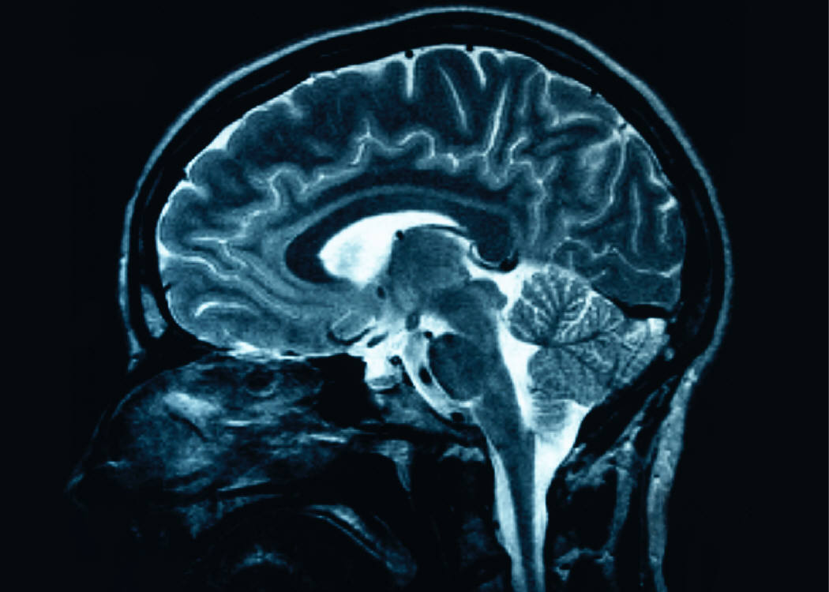
Medical Marijuana and HIV/AIDS:
Reasons for Caution
In advanced disease stage, HIV enters nervous system, leading to HIV-Associated Neurocognitive Disorders (HAND)
  Symptoms: Confusion, forgetfulness, headaches
Three main types of HAND
  Asymptomatic Neurocognitive Impairment: impaired cognitive ability, but able to function
  Mild Neurocognitive Disorder: Impaired cognitive ability, mild interference in daily activity
  HIV-Associated Dementia:
  Major impairments in cognition,
  daily functioning
Notes:
One of the major reasons people living with HIV should be cautious with marijuana is because HIV disease can cause HIV-Associated Neurocognitive Disorders (HAND) in advanced stages. The main symptoms of HAND include confusion, forgetfulness, and headaches. Three different types of HAND exist—asymptomatic neurocognitive HAND, mild neurocognitive disorders, and HIV-Associated Dementia.

Slide 68
Medical Marijuana and HIV/AIDS: Reasons for Caution
Long-term marijuana use impairs learning and memory
47% of HIV+ marijuana users report memory problems
Marijuana’s cognitive effects particularly strong for people experiencing HAND
Concern that cognitive impairment may compromise ART adherence
  Forgetting to take medication is the leading cause of ART non-adherence
  Use of most recreational drugs and alcohol is associated with lower ART adherence, less virological suppression, slower CD4 cell response rate
SOURCES: Chesney, 2003; Cristiani et al., 2004; Wooldridge et al., 2005.
Notes:
Given the effects HIV can have on cognition, people living with HIV should be careful with marijuana, which also affects learning and memory. Almost half of HIV-positive marijuana users report having memory problems, and the drug’s cognitive effects may be particularly strong for people experiencing HAND. Cognitive impairment may also compromise adherence to ART, since forgetting medication is the leading cause for ART non-adherence. Research shows that the use of most recreational drugs and alcohol is associated with lower antiretroviral medication adherence, less virologic suppression, and slower CD4 cell response rate.
REFERENCES:
Chesney, M. (2003). Adherence to HAART Regimens. Aids Patient Care and STDs, 17(4), 169-177.
Cristiani, S.A., Pukay-Martin, N.D., & Bornstein, R.A. (2004). Marijuana Use and Cognitive Function in HIV-Infected People. The Journal of Neuropsychiatry & Clinical Neurosciences, 16(3), 330-335.
Woolridge, L., et al. (2005). Interaction between the CD8 Coreceptor and Major Histocompatibility Complex Class I Stabilizes T Cell Receptor-Antigen Complexes at the Cell Surface. The Journal of Biological Chemistry, 280, 27491-27501.

Slide 69
Medical Marijuana and HIV/AIDS
Food for Thought
Studies have thus far not identified long-term negative effects of regular cannabis use on the progression of HIV
Two interesting recent studies:
  Recently diagnosed individuals reporting daily cannabis use had significantly lower HIV plasma viral load levels one year after diagnosis than individuals reporting little or no cannabis use, even after controlling for age, gender, ethnicity, homelessness, alcohol use, injection drug use, and non-injection drug use
SOURCE: Milloy, 2015
Notes:
Consider these studies that indicate that the interaction between marijuana and HIV may not be as detrimental as indicated by previous studies (however, take this information with some caution until additional research is able to replicate or broaden findings). Studies have not been able to identify long-term negative effects of regular cannabis use on the progression of HIV. A recent study found that recently-diagnosed individuals who also used cannabis daily reported lower HIV plasma viral load levels one year following diagnosis than individuals who did not use. This study found these results even after controlling for age, gender, ethnicity, homelessness, and other alcohol/illicit drug use.
REFERENCE:
Milloy, M.J. (2015). High-intensity cannabis use associated with lower plasma HIV-1 RNA viral load among recently infected people who use injection drugs. Drug and Alcohol Review, 34, 135-140.

Slide 70
Medical Marijuana and HIV/AIDS
Food for Thought
Longitudinal study of 523 HIV+ illicit drug users (median age = 45),
  No difference in antiretroviral adherence rates between individuals reporting daily cannabis use vs those reporting occasional or no cannabis use, again after controlling for possible confounding variables
  Daily alcohol, heroin, cocaine, & crack use were all associated with lower ART adherence
SOURCE: Slawson, 2015
Notes:
The second study looking at medical marijuana and HIV/AIDS was a longitudinal study of 523 HIV positive illicit drug users with a median age of 45. During this study, researchers found that there was no difference in antriretroviral adherence rates between daily cannabis users and individuals infrequently or never using cannabis. However, daily alcohol, heroin, coacine and crack use were all associated with lower ART adherence.
REFERENCE:
Slawson, G., et al. (2015). High-intensity cannabis use and adherence to antiretroviral therapy among people who use illicit drugs in a Canadaian setting. AIDS & Behavior, 19, 120-127.

Slide 71

Aging and the Brain
Notes:
INSTRUCTIONS
This slide serves as the transition to discussing the effects of aging on the brain in combination with previously discussed neurocognitive impairments that can result from HIV/AIDS; this section also discusses the impact of drugs on the brain.

Slide 72
Age-Related Changes in the Brain
Shrinking of the prefrontal cortex and hippocampus
White matter begins to degrade which impacts brain communication
Arteries and capillaries can harden or shrink which impacts blood flow
Plaques and tangles can develop in and around neurons
Inflammation increases
Notes:
A number of changes occur in the brain as an individual ages – some produce structural changes that may or may not result in functional analogues. The prefrontal cortex and hippocampus can begin to shrink and as gray matter changes in these and other regions, impacts on memory and decision-making may be experienced. White matter can also begin to degrade which can impact the communication between brain regions as well as the learning of new information. Myelin, the protective sheathing around axons, can begin to degrade which impairs communication as well. As arteries and capillaries shrink and harden, blood flow can be impaired to certain regions. Plaques and tangles can develop in and around neurons which are identified as contributing to the development of Alzheimer’s Disease and other neurodegenerative diseases. Inflammation in general increases and chronic inflammation can be detrimental to tissue.

Slide 73
Age-Related Changes in the Brain
Difficulty remembering information
Initial completion of tasks is slower than compared to a younger person
Factors that may help to compensate for deficits are
  Increases in or more extensive vocabulary
  Score similar to younger adults on cognitive tests when given additional time
Notes:
As individuals age, remembering information becomes more difficult and initial completion of a task is slower when compared to a younger person. However, older adults demonstrate other factors that may compensate for age-related deficits such as increases in or a more extensive vocabulary. Older adults also demonstrated scores on cognitive tasks similar to younger adults when given additional time indicating that while responses on timed performance tasks may be lengthened, older adults do not as a rule experience significant cognitive impairments simply as a byproduct of aging.
Additional information for Trainer(s)
Individually, there are factors in substance use and aging that impact the brain and cognitive functioning; when put together, a compounding effect may result. When encountering deficits in clinical practice, it may be a combination of age-related, substance use and HIV changes in the brain
The ACTIVE study (n=2802) was a longitudinal study of 65 and older adults living independently. The adults were given initial testing then an 11 month booster and once a year for 5 years following that to measure cognitive performance.
4 groups were created, three received 10-session computer-based cognitive testing on memory, reasoning, speed of processing. Fourth group was control group. A 75 minute booster training was offered 11 months later to 60% of participants
After initial training, 87% of processing speed group showed improvement, 74% of reasoning group, and 26% of memory group. After 5 years, people in each group performed better on skills initially taught then controls. Reasoning and speed participants who also received a booster showed the greatest levels of maintenance. The results demonstrated that older adults’ fears about cognitive decline may be reduced due to an effect on longer-lasting improvments when engaged in relatively brief, on-going cognitive coping exercises.
REFERENCE:
Willis, S.L. et al. (2006). Long-term Effects of Cognitive Training on Everyday Functional Outcomes in Older Adults. The Journal of the American Medical Association, 296(23), 2805-2814.

Slide 74
HIV-Related Cognitive Impairment
Approximately 50% of PLWHA experience HIV-Associated Neurocognitive Disorders (HAND)
More common in women and those with lower premorbid IQ
Severe depression frequently associated with cognitive impairment
Appears to be a strong correlation between depression and HAND (Simioni et al)
Notes:
About half of PLWHA experience HIV-Associated Neurocognitive Disorders (HAND). HAND is more common in women and those with lower premorbid IQ. Severe depression is frequently associated with impairments in cognitive functioning in general, and there appears to be a strong correlation between depression and HAND.
Additional information for the Trainer(s)
Cognitive impairment is related to a change in cerebral white matter – specifically in the internal capsule, corpus callosum and superior longitudinal fasciculus
All HIV-infected groups showed abnormal white matter in internal capsule, inferior longitudinal fasciculus, and optic radiation (white matter tract injury and cognitive impairment in HIV-infected individuals).
REFERENCES:
Gongvatana, A. et al. (2009). White matter tract injury and cognitive impairment in human immunodeficiency virus-infected individuals. Journal of Neurovirology, 15(2), 187-195.
Simoni, J.M, Pantalone, D.W., Plummer, M.D., Huang, B. (2007). A randomized controlled trail of a peer support intervention targeting antiretroviral medication adherence and depressive symptomatology in HIV-positive men and women. Health Psychology, 26(4), 488-495.

Slide 75
HIV-Related Cognitive Impairment
10% of older HIV-seropositive patients in Australia had CSF markers consistent with Alzheimer’s: over 10 times the prevalence in similar age general population (Cysique et al, 2013)
Problems with balance and lightheadedness, associated with risk of falls, are more common
Polypharmacy associated with increased risk of falls
High educational level may indicate a protective factor against HAND
Notes:
A study in Australia noted that 10% of older HIV-seropositive patients in Australia had cerebrospinal fluid markers that were consistent with Alzheimer’s. This percentage was over 10 times higher than the prevalence in the general population of the same age. In addition, individuals with HIV-related cognitive impairments have increased problems with balance and lightheadedness which is associated with a risk of falls. Polypharmacy and taking multiple medications also increases fall risk. All of these factors, including being an older adult, can contribute to more detrimental impacts of falls sustained. While one study noted that individuals on ARVs were 50% less likely to fall, other studies have demonstrated reduced bone density while on ARVs and an increase in risk of falls with polypharmacy, including psychotherapeutics.
While there is research that indicates risk of falls and injury as a result of multiple medications and co-occurring diagnoses, some research indicates that a higher educational level may act as a protective factor against HAND.
REFERENCES:
Cysique, L., et al. Prevalence of CSF Alzheimer’s disease-like profile in chronic middle-aged HIV+ individuals. 20th Conference on Retroviruses and Opportunistic Infections. March 3-6, 2013. Atlanta. Abstract available at: http://www.retroconference.org/2013b/PDFs/442.pdf
Erlandson, K.M, et al. (2012). Risk Factors for Falls in HIV-Infected Persons. Journal of Acquired Immune Deficiency Syndromes, 61(4), 484-489.
Paternico, D. et al. (2012). Cerebrospinal fluid markers for Alzherimer’s disease in a cognitively health cohort of young and old adults. Alzheimer’s & Dementia, 8, 520-527.

Slide 76
Successful Cognitive Aging in Older PLWHA
Successful Cognitive Aging (SCA)
  Individual is free from actual cognitive impairment and subjective experience of cognitive impairment
Is it possible with HIV+ older adults?
32% of HIV+ adults with at least 5 yrs duration of infection met criteria for SCA
  Mean age: 51
  Better mood function
  Fewer declines in activities of daily living (ADL)
  Higher medication adherence
  More confidence dealing with healthcare providers
SOURCE: Malaspina et al, 2011
Notes:
Successful Cognitive Aging (SCA) is possible in which an individual is free from actual cognitive impairment and subjective experience of cognitive impairment. Among HIV-positive adults with at least 5 years duration of infection, 32% met criteria for SCA. The average age was 51 and these adults exhibited better mood, fewer declines in activities of daily living (ADL), better medication adherence, and more confidence in dealing with healthcare providers.
Recommendations are to look at cognitive functioning from a strengths-based perspective rather than the usual deficit-focused one. “Successful cognitive aging may be a determinant of adaptive real-world functioning and well-being among PLWHA”.
SCA is typically assessed with a battery of neuropsychological tests.
REFERENCE:
Malaspina, L., et al. (2011). Successful cognitive aging in persons living with HIV infection. Journal of Neurovirology, 17, 110-119.

Slide 77
Successful Cognitive Aging in Older PLWHA
Among 50 & older HIV+ adults in San Diego, SCA associated with:
  Better emotional and social functioning
  Less fatigue
  Better general health
  Unfortunately, older HIV+ adults much less likely to have SCA (19%) than younger HIV+ adults (42%), older HIV- adults (45%), or younger HIV- adults (48%)
  No difference between older & younger on SUD
SOURCE: Moore et al., 2014
Notes:
Researchers in San Diego have focused specifically on characteristics associated with improved SCA among older, HIV+ adults (50 and older). They found that successful cognitive aging is associated with better emotional and social functioning, less fatigue, better overall health. However, they also found that older HIV-positive adults are much less likely to have SCA than younger individuals. They found no difference between the older and younger groups on problematic substance use behaviors.
REFERENCE:
Moore, R.C., et al. (2014). Successful cognitive aging and health-related quality of life in younger and older adults infected with HIV. AIDS & Behavior, 18, 1186-1197.

Slide 78

When Do Changes Occur?
“after midlife, at higher ages (70 or higher)”
“the late seventies”
“about 50 years old”
“around age sixty”
“…not before age 55”
SOURCE: Aartsen et al, 2002; Albert & Heaton, 1988; Plassman et al, 1995; Ronnlund et al, 2005; Schaie, 1989
Notes:
**ANIMATION**
On click, the text will animate into the slide. There are five quotes from various articles that identify the age at which cognitive changes begin to occur. Research has to this point not conclusively identified a specific point in time that structural and performance changes begin to occur. A number of factors contribute to changes in the brain and also the brain’s ability to continue to learn new information as an individual gets older.
After midlife, at higher ages (70 or higher): Aartsen, 2002; indicated that cognitive decline may begin after midlife but will typically occur at higher ages, around 70 or older.
About 50 years old: Albert, 1988; indicated that there is little decline in performance until about the age of 50.
Around age sixty: Plassman, 1995; stated that cognitive abilities generally remain consistent and stable without declines in performance until about the age of 60.
Not before age 55: Ronnlund, 2005; found that there was little or no drop whatsoever in performance before the age of 55
The late seventies: Schaie, 1989; found that abilities tended to peak before the 50s and will plateau without any appreciable decline. Mentioned that in the fifties and sixties, possible that there is slow decline that will accelerate as the late seventies are reached.
REFERENCES:
Aartsen, M.J., Smits, H.M., van Tiburg, T., Knipscheer, K.C., & Deeg, D.J. (2002). Activity in Older Adults Cause or Consequence of Cognitive
Functioning? A Longitudinal Study on Everyday Activities and Cognitive Performance in Older Adults. The Journals of Gerontology, 57(2), 153-162.
Albert, M.S., Heaton, R.K. (1988). Intelligence testing. In: Albert, MS.; Moss, MB., editors. Geriatric Neuropsychology. New York: Guilford Press; p. 13-32.
Plassman, B.L., et al. (1995). Intelligence and education as predictors of cognitive state in late life: A 50-year follow-up. Neurology, 45, 1446-1450.
Ronnlund, M., Nyberg, L., Backman, L., & Lars-Goran, N. (2005). Stability, Growth and Decline in Adult Life Span Development of Declarative Memory: Cross-Sectional and Longitudinal Data From a Population-Based Study. Psychology and Aging, 20(1), 3-18.
Salthouse, T.A. (2009). When does age-related cognitive decline begin? Neurobiology of Aging, 30(4), 507-514.
Schaie, K.W. (1989). Individual differences in rate of cognitive change in adulthood. In: Bengston, VL.; Schaie, KW., editors. The Course of Later Life: Research and Reflections. New York: Springer; p. 65-85.
Photo credit: Centers for Disease Control and Prevention, State of Aging and Health in America 2013, http://www.cdc.gov/features/agingandhealth/state_of_aging_and_health_in_america_2013.pdf

Slide 79
Methamphetamine
Notes:
INSTRUCTIONS
This slide serves as the transition to discussing the effects of methamphetamine and other drugs on the brain. This information continues to build on information that has been presented to identify additional impairments in functioning that individuals may encounter with patients.

Slide 80
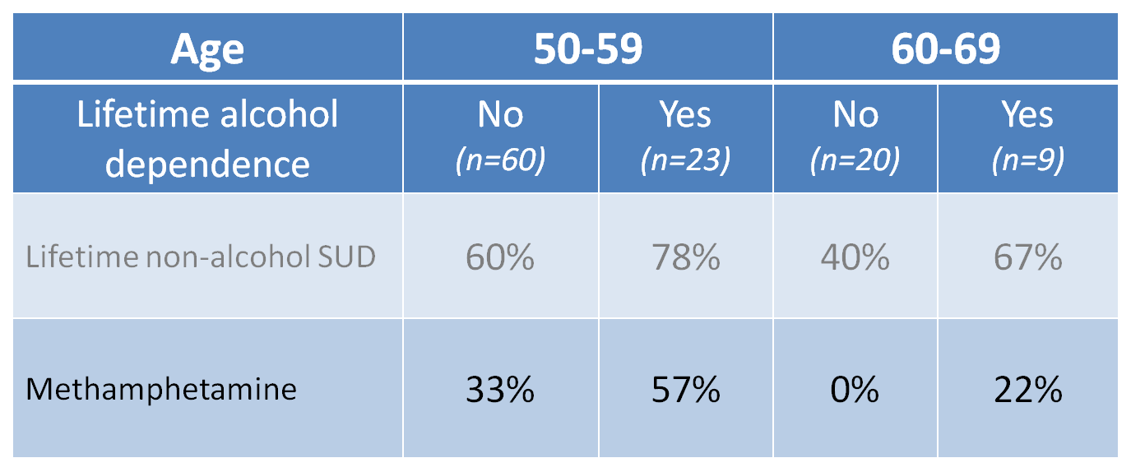
HIV and Substance Use
Drug Use by Age and
Alcohol Dependence (n=112)
SOURCE: Gongvatana et al, 2014
Notes:
This table references the same study that was presented on Slide 41, expanded to show the percentage of individuals who are using methamphetamine in addition to having a lifetime occurrence of alcohol dependence. The main point of the slide is to identify that while overall methamphetamine use among HIV-positive individuals decreases as the individuals get older, if the individual has alcohol dependence, they are more likely to use meth than their non-alcohol dependent counterparts.
In the 50-59 age group, 33% of individuals who had never had an occurrence of alcohol dependence reported using methamphetamine; in the same age groups, among individuals who had identified a lifetime occurrence of alcohol dependence, 57% had used meth. Among the older age group (60-69), 22% reported lifetime alcohol dependence and methamphetamine use. Interestingly, among 60-69 year olds, the individuals who reported no co-occurring lifetime alcohol dependence similarly reported no meth use.
Additional information for the Trainer(s)
At first, people may perceive what seem to be positive effects with drug use. They also may believe that they can control their use; however, drugs can quickly take over their lives. Over time, if drug use continues, pleasurable activities become less pleasurable, and drug abuse becomes necessary for abusers to simply feel "normal." Drug abusers reach a point where they seek and take drugs, despite the tremendous problems caused for themselves and their loved ones. Some individuals may start to feel the need to take higher or more frequent doses, even in the early stages of their drug use.
The initial decision to take drugs is mostly voluntary. However, when drug abuse takes over, a person's ability to exert self-control can become seriously impaired. Brain imaging studies from drug-addicted individuals show physical changes in areas of the brain that are critical to judgment, decision making, learning and memory, and behavior control. Scientists believe that these changes alter the way the brain works, and may help explain the compulsive and destructive behaviors of addiction.

Slide 81
Cognitive effects of chronic substance use and dependence
Short-term and mid-term effects of most substances are well-documented
There is little evidence for the long-term effects of:
  Alcohol
  Cannabis
  MDMA
Limited data exists on the long-term effects of:
  Cocaine
  Methadone
  Benzodiazepines
  Other prescription drugs
  Other club drugs
There is evidence for the long-term effects of:
  Heroin
  Methamphetamine
SOURCE: Fernandez-Serano, Perez-Garcia, & Verdejo-Garcia. 2011
Notes:
**ANIMATION**
This slide animates in three parts. With each click, each dimmed section will be highlighted.
Click to highlight the first section:
While there is substantial evidence about the short-term and mid-term effects and harm of substances, there is little evidence for the long-term cognitive effects of alcohol, cannabis, and MDMA (ecstasy).
Click to highlight the second section:
There is some evidence of the long-term cognitive effects of cocaine, methadone, benzodiazepines, prescription drugs, club drugs; however, this information is limited.
Click to highlight the final section:
There is extensive research and evidence that indicates significant long-term cognitive impairments when using heroin and methamphetamine.
Additional information for the Trainer(s)
Little evidence of long-term impairment exists for the drugs listed; additionally, limited data is available for cocaine, etc. However, for heroin and meth, we know that substantial longer-term impacts can result.
We discussed general cognitive effects of aging and the impact of longer-term substance use on cognitive functioning (we know that longer duration of use and earlier onset of use contribute to the development of more significant cognitive impairments).
Older adults who have been using longer would then be subjected to normal cognitive declines in functioning as a result of aging (discussed previously) as well as longer-term deficits due to substance use – we know this particularly well with heroin and meth which is the two most studied drugs. This is especially relevant to individuals living longer with HIV, living into their 50s, 60s, and 70s which, prior to the development of HAART, was often not the case.
REFERENCE:
Fernandez-Serrano, M.J., Perez-Garcia, M., Verdejo-Garcia, A. (2011). What are the specific vs. generalized effects of drugs of abuse on neuropsychological performance? Neuroscience & Biobehavioral Reviews, 35(3), 377-406.

Slide 82

Normal Dopamine
Transmission
Notes:
**ANIMATION**
Upon click, the title will disappear and the video will begin to play full screen.
The video that will play shows an animation of the process of dopamine transmission in the brain. The video shows a synapse where an axon terminal (end of a neuron) will communicate information to a different neuron by releasing the neurotransmitter (dopamine) into the synapse where it will be picked up by receptor on the receiving neuron (dendrite). This is the normal process by which neurotransmitters are able to trigger activation of certain neurons and thereby certain functions within the brain.

Slide 83
Natural Rewards Elevate
Dopamine Levels
FOOD
SEX
200
200
NAc shell
150
150
DA Concentration (% Baseline)
100
100
15
% of Basal DA Output
Empty
10
50
Copulation Frequency
Box
Feeding
5
0
0
0
60
120
180
Scr
Scr
Scr
Scr
Time (min)
Bas
Female 1 Present
Female 2 Present
Sample
Number
1
2
3
4
5
6
7
8
9
10
11
12
13
14
15
16
17
Mounts
Intromissions
Ejaculations
Source: Di Chiara et al.
Source: Fiorino and Phillips
Notes:
**ANIMATION**
This slide will automatically animate. The “Food” image will animate in, followed by the “Sex” image two seconds later.
This slides shows the dopamine output compared to baseline in an animal model. Looking at the red line above, with 100 as baseline, when a male rat is fed, his dopamine output spikes and increases 50% (from 100 to 150). The slide on the right shows that during sexual activity, a male rat’s dopamine output spikes to 200, from 100 (100% increase).

Slide 84
Methamphetamine
and Dopamine
Notes:
**ANIMATION**
Upon click, the title will disappear and the video will begin to play full screen.
The video that will play shows a similar animation to the “Normal Dopamine Transmission” video. The effect of methamphetamine, as demonstrated in the video, is to release an unnatural amount of dopamine into the synapse which enhances the feeling of pleasure. However, methamphetamine also blocks the extra dopamine from being re-absorbed. This process can actually damage receptors which is detrimental to neural functioning.
Additional information for the Trainer(s)
While excess dopamine can damage neural functioning, a key difference in the harmful effects of methamphetamine as compared to cocaine is a result of the fact that methamphetamine blocks the re-absorption of dopamine. This process by which methamphetamine blocks those transporters (as seen in the video) does not occur with cocaine use.

Slide 85
Drugs Also Bring Reward (via Dopamine)
250
Accumbens
ETHANOL
250
NICOTINE
200
200
150
% of Basal Release
% of Basal Release
150
100
100
0
0
0
1
2
3 hr
0
1
2
3
4hr
Time After Nicotine
Time After Ethanol
COCAINE
1500
1000
500
0
METHAMPHETAMINE
400
Accumbens
Accumbens
300
% of Basal Release
200
% Basal Release
100
0
0
1
2
3
4hr
0
1
2
3hr
Time After Cocaine
Time After Methamphetamine
Source: Shoblock and Sullivan; Di Chiara and Imperato
Notes:
**ANIMATION** This slide animates in four parts
This slide demonstrates what happens to dopamine release in the brain when drugs are introduced.
Click to reveal the first box “Ethanol”
In a similar study as before (the “food/sex” study on Slide 83), when given ethanol, dopamine output in the rat subject increased to levels comparable to the release of dopamine that occurs with sexual activity.
Click to reveal the second box “Nicotine”
With nicotine, there is an even larger spike in dopamine release – to about 225 which is 12.5% higher than with sexual activity or ethanol. Consider how nicotine behaviors often “combine” dopamine-producing activities (e.g. having a cigarette and a drink, having a cigarette after eating, having a cigarette after sex).
Click to reveal the third box “Cocaine”
The increase with cocaine is even higher than the previous two. Cocaine causes a release in dopamine at around 350, 75% higher than sexual activity or smoking. Note also the longer duration that dopamine stays at higher levels with cocaine.
Click to reveal the final box “Methamphetamine”
The increase with methamphetamine is significantly higher than any of the previously discussed substances and produces an effect that would be almost impossible to replicate without using meth. The dopamine release increases to about 1250. It is clear based on this graph and what we know about the function of dopamine why individuals would continue to use meth despite negative consequences.
REFERENCES:
Di Chiara, G., & Imperato, A. (1988). Drugs abused by humans preferentially increase synaptic dopmaine concentrations in the mesolimbic system of freely moving rats. Proceedings of the National Academy of Sciences, 85, 5274-5278.
Shoblock, J.R., Sullivan, E.B., & Maissonueve, I.M., Glick, S.D. (2003). Neurochemical and behavioral differences between d-methamphetamine and d-amphetamine in rats. Psychopharmacology, 165, 359-369.

Slide 86
Cognitive and
  Memory Effects
Notes:
INSTRUCTIONS
This slide serves as a transition from talking about the role of dopamine and how drugs affect the release of dopamine in the brain to examining the functional impairments that result from continued drug use.

Slide 87
Memory Difference between Stimulant and Comparison Groups
Notes:
In a study that demographically matched methamphetamine users with control participants to identify differences in cognitive and memory functioning, results showed that the control group performed better than the meth group in both word recall and picture recall tasks. Considering the meth group only, participants performed better on picture recall than on work recall. The implication of this information is that, often times, much of the health information that is delivered in a primary care, mental health or substance abuse setting is either written or verbal. Providers should consider alternative ways of engaging stimulant-using patients.
REFERENCE:
Simon, S.L., et al. (2002). Cognitive performance of current methamphetamine and cocaine abusers. Journal of Addictive Diseases, 21(1), 61-74.

Slide 88
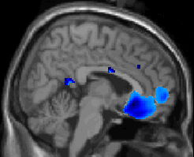
The Effect of Meth on the Brain
Control
> MA
4
3
2
1
0
Notes:
INSTRUCTIONS
This slide presents an image of a sagittal cross section of the brain with the face on the right side of the slide. Note that “blue” indicates reduced functioning in that area of the brain of meth users. Focus specifically on that large region at the front and connect the lack of activity with this particular region’s functioning: frontal lobe is responsible for executive functioning, including decision-making, logical thinking, planning and organizing and inhibitory control of the amygdala. This connects with the information on the next slide.

Slide 89
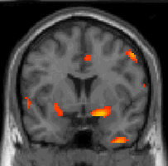
The Effect of Meth on the Brain
MA >
Control
5
4
3
2
1
0
Notes:
INSTRUCTIONS
Similar to the previous slide, this is cross section of the brain looking at areas that are highly activated in meth users. The cross-section is coronal, “ear-to-ear,” and the yellow area most highlighted is the amygdala – responsible for interpreting and encoding memories and activating emotional responses. Paired with the last slide, we see an over-activation in emotional responses without inhibitory control, “all gas and no brakes.”

Slide 90


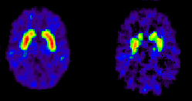
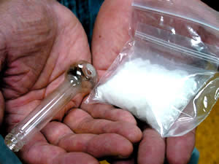
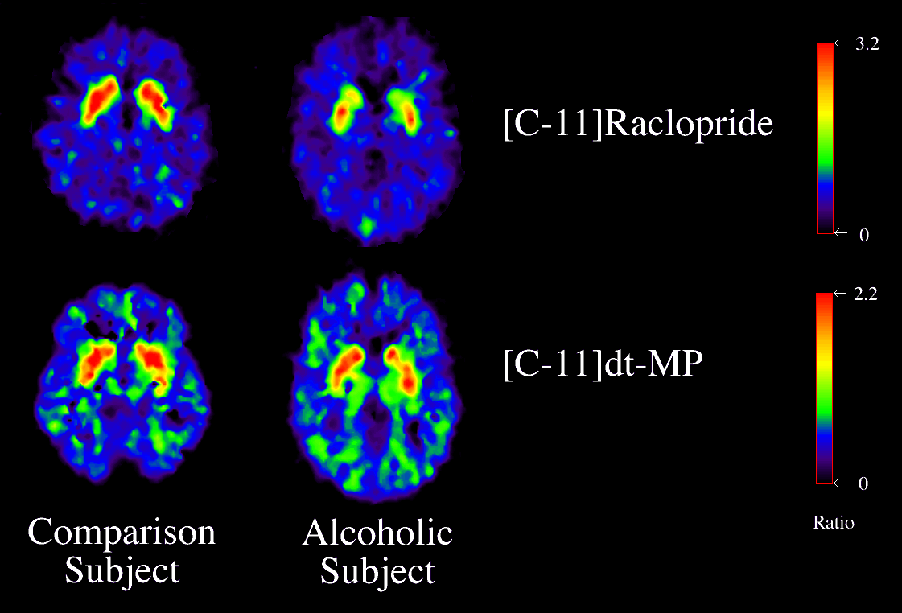

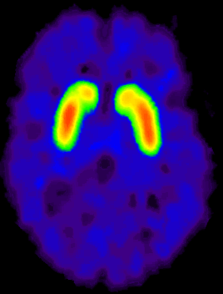
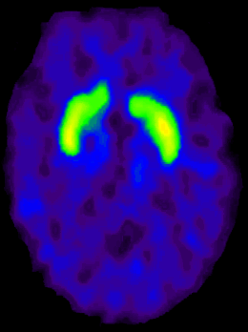
Dopamine D2 Receptors are Lower in Addiction
DA
DA
Cocaine
DA
DA
DA
DA
DA
DA
DA
DA
DA
DA
Meth
Reward Circuits
Non-Drug Abuser
DA D2 Receptor Availability
DA
Alcohol
DA
DA
DA
DA
DA
Heroin
Reward Circuits
Drug Abuser
control
addicted
Notes:
PET scans of various drug users matched to controls showed decreased dopamine D2 receptors, independent of the type of drug used. Specific changes occur during withdrawal with reduced dopamine activity, as measured by decreased dopamine D2 receptors.
Lower dopamine D2 receptor levels are generally associated with increased effects of cocaine and other stimulants in drug abusing individuals, indicating a stronger effect in activation of the reward circuits associated with dopamine D2 receptor activation. The opposite is seen in non-drug abusing controls; greater dopamine D2 receptor availability produces a less rewarding and pleasurable effect compared to the lower D2, drug abusing groups.
REFERENCE:
Volkow, N.D., Fowler, J.S., Wang, G.J., & Swanson, J.M. (2004). Dopamine in drug abuse and addiction: results from imaging studies and treatment implications. Molecular Psychiatry, 9, 557-569.

Slide 91
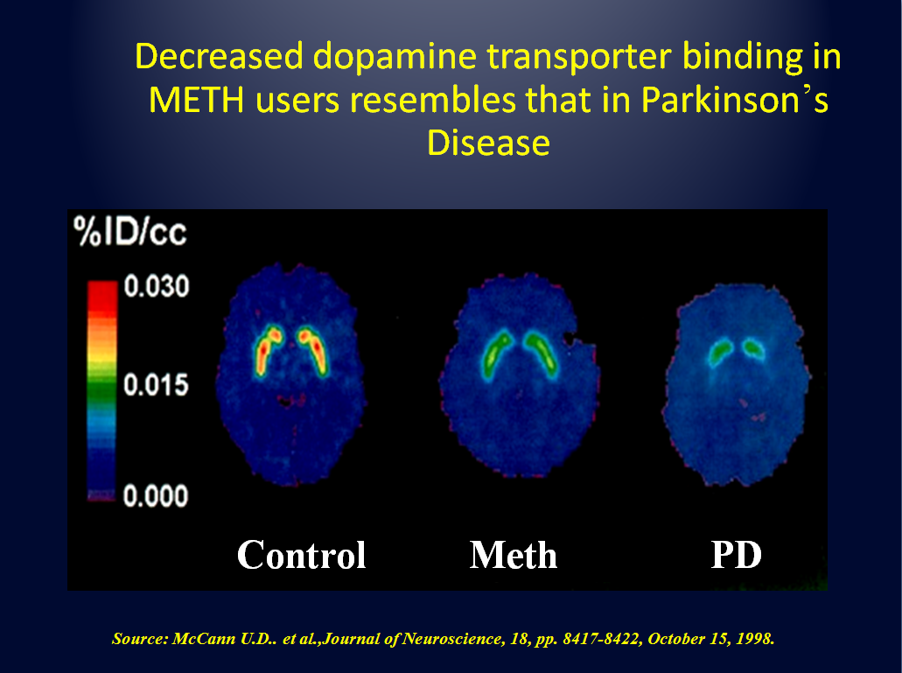
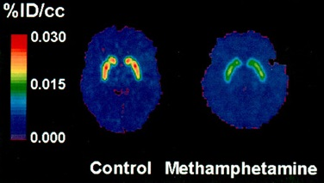

Decreased dopamine transporter binding in METH users resembles that in Parkinson’s Disease
A 2015 study in Utah found that meth users were 300% more likely to develop Parkinson’s disease compared to non-users and cocaine users.
Study also found that risk may be higher for female users.
A 2011 study examined 300,000 hospital records spanning 16 years and found that patients with methamphetamine-use disorders were 75% more likely to develop Parkinson’s disease
Control Meth PD
SOURCE: Curtin, K. et al, 2015
Notes:
**ANIMATION** This slide animates in two parts
Compared to controls, meth users have significantly reduced dopamine transporter binding, evidenced by these matched-control PET scans. The dopaminergic activity in the meth users looks similar to individuals who have been diagnosed with Parkinson’s Disease. As the impact of meth on dopamine functioning and transporter binding has been known for some time, it has been speculated that individuals who used meth may be at greater risk for developing Parkinson’s Disease compared to non-users.
Upon click, the image will shrink and move to the top left of the slide. Updated information from a 2011 study will be presented.
In fact, there is additional information as to whether use of meth does or does not contribute to development of Parkinson’s Disease as has been suspected based on brain imaging of the impact of meth on dopamine. In 2011, a study was conducted that examined hospital records for over 300,000 patients. Looking at information that spanned 16 years, the researchers found that patients who were using methamphetamine were 75% more likely to develop Parkinson’s Disease than individuals whose charts indicated no meth use.
Upon click, the slide will shift once more; the text on the right will shrink and move below the image and the most updated information will be presented to the right.
As this was the only study of its kind at the time, the link between meth and Parkinson’s still required additional research. As of 2015, a study conducted in Utah examined over 8 million records spanning more than a century and not only confirmed the information of the 2011 California study but demonstrated that individuals who were using meth were 300% more likely to develop Parkinson’s Disease when compared to both non-users and cocaine users, clearly indicating the longer-term neurotoxic and detrimental effects of meth on brain functioning as compared to cocaine use. The study also found that the risk may be higher for female users though this requires additional focus.
REFERENCES:
Curtin, K. et al. (2015). Methamphetamine/amphetamine abuse and risk of Parkinson’s disease in Utah: A population-based assessment. Drug and Alcohol Dependence, 146, 30-38.
McCann, U.D., et al. (1998). Reduced Striatal Dopamine Transporter Density in Abstinent Methamphetamine and Methcathinone Users: Evidence from Positron Emission Tomography Studies with [11C]WIN-35,428. The Journal of Neuroscience, 18(20), 8417-8422.

Slide 92
How much does the brain heal?
Notes:
INSTRUCTIONS
This slide serves to transition to a discussion of whether or not the brain heals from the detrimental effects of prolonged substance use and the implications for treatment.

Slide 93
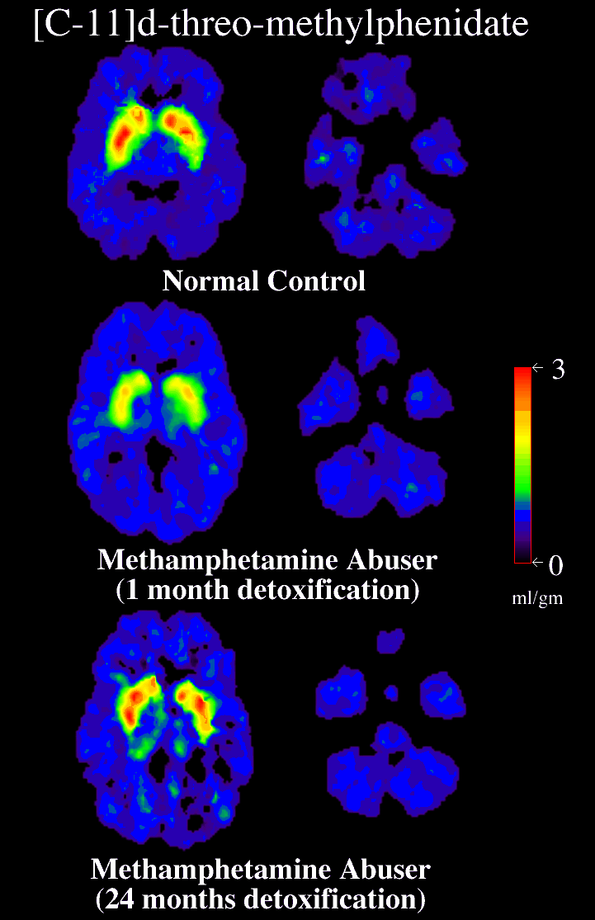
Partial Recovery of Brain Dopamine Transporters in Methamphetamine Abuser After Protracted Abstinence
3
0
ml/gm
Normal Control
METH Abuser
(1 month detox)
METH Abuser
(24 months detox)
Source: Volkow, ND et al., Journal of Neuroscience 21, 9414-9418, 2001.
Notes:
The brain still has the opportunity to recover from the detrimental effects of substance use. In PET scans that compared meth abusers to normal controls, improvements in dopamine transporter functioning is observed at about 24 months, post detox. At about 1 month post detox, functioning is still significantly impaired and may continue to decrease for up to 6 months. However, the neuroplasticity and ability for the brain to recover provides hope in treatment.
Consider brain recovery in the context of aging. All literature says the earlier someone can stop, the better chance the brain has to recover. The longer someone uses, the more difficult this becomes. It is also important to note that the period of time when dopamine transporter activity is reduced will be difficult for the individual. In addition to cognitive impairments and withdrawal symptoms, the desire to use again may be substantial. Furthermore, recovery of neuronal connections may not occur in the same way as prior to drug use; this results in lasting changes in functioning such as irritability, feelings of depression, transitory hallucinations, etc. The provider can assist the patient by providing education around recovery and providing support as recovery progresses.
REFERENCE:
Volkow, N.D., et al. (2001). Loss of dopamine transporters in methamphetamine abusers recovers with protracted abstinence. Journal of Neuroscience, 21, 9414-9418.

Slide 94
Case Example: Latino Male
Pt is a 55yo Latino MSM referred by HIV care clinic for severe depression and SUD treatment
Very visible, successful PR executive for 20 years
Meth use approx 2-3 times/month, during which he has unprotected sex with multiple anonymous men; this is his only sexual activity
Has never identified as gay, despite only having sex with men
Because he is terrified of the possibility of testing positive, he has never had an HIV test
Continues to work until a day when he can’t get out of bed
Neighbor calls 911; at hospital he is diagnosed with cryptococcal meningitis and AIDS; viral load is in the millions and CD4 count is 55
Upon d/c he presents at your outpatient HIV care clinic for continuing care
What are some of his mental health and substance-related issues and needs, and what are some of the first actions you might take with him?
Notes:
INSTRUCTIONS
**Allow 3-5 minutes for this activity; individuals can pair up or work in larger groups, depending on audience size**
Read the case example out loud and ask the participants to identify presenting issues that would be clinical focus knowing what they know about the interaction of different substances, HIV, and older adults up to this point.
Focus on the last bullet point and allow 5-7 minutes for a general discussion regarding their impressions and how they would approach the case once groups have had a chance to talk amongst themselves.

Slide 95

Co-Occurring Conditions
Notes:
INSTRUCTIONS
This slide serves to tranisiton to integrating the information presented previously with the possibility of co-occurring mental health impairments an older adult PLWHA may be experiencing.

Slide 96
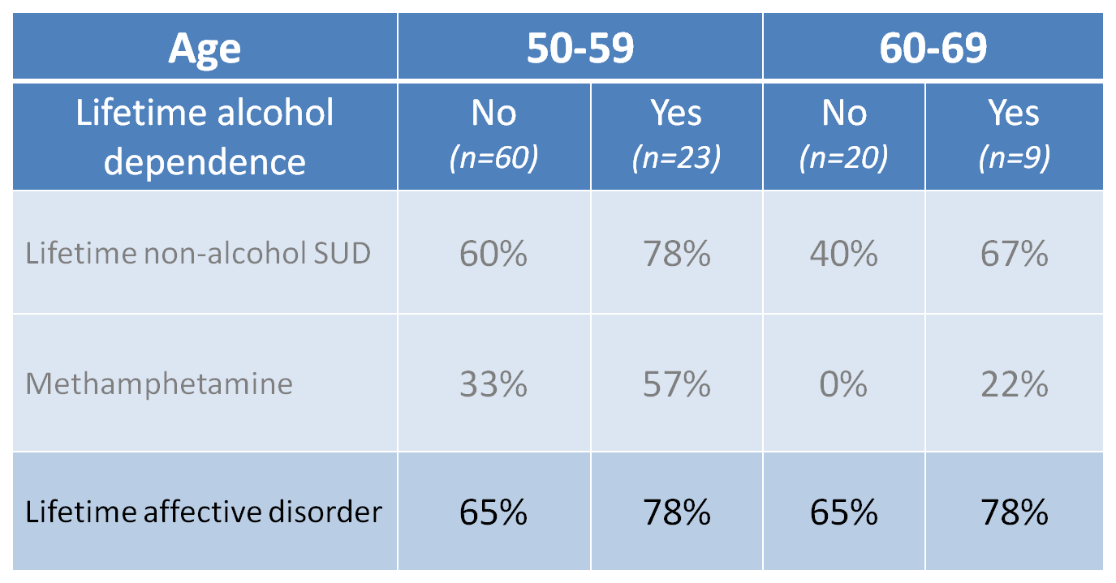
HIV and Co-Occurring Conditions
Affective Disorders and Drug Use by Age and
Alcohol Dependence (n=112)
SOURCE: Gongvatana et al, 2014
Notes:
This table references the same study that was presented on Slides 41 and 80, expanded to show the percentage of individuals with a lifetime occurrence of alcohol dependence who have also had a lifetime occurrence of an affective disorder. The main point of the slide is to identify that there is a strong co-occurrence of a lifetime affective disorder for individuals with HIV overall and slightly higher for individuals with a co-occurring lifetime alcohol dependence disorder.
In the 50-59 age group, 65% of individuals who had never had an occurrence of alcohol dependence reported a lifetime occurrence of an affective disorder; in the same age groups, among individuals who had identified a lifetime occurrence of alcohol dependence, 78% reported a lifetime affective disorder. Among the older age group (60-69), 65% reported having had an affective disorder and no occurrence of alcohol dependence. For individuals 60-69, those with lifetime alcohol dependence had a 78% chance of also having a lifetime affective disorder. Interestingly, there was no difference in the prevalence of co-occurrence of lifetime affective disorders when comparing the 50-59 group with or without alcohol dependence to its corresponding group among the 60-69 year old group.

Slide 97

HIV and Co-Occurring Conditions
Conditions Common in Older PLWHA
Depression
Alcohol/drug abuse
Social isolation
Lack of support network
Experience of stigma
Inadequate access to healthy food
Lack of mobility
Poor eyesight
Cognitive impairment
Numerous side effects due to interaction of medications for multiple chronic conditions
Notes:
A number of conditions are common in older PLWHA and can impact treatment.
Depression: depression is a common problem experienced by older adults. Symptoms may not be immediately apparent and are sometimes attributed to part of a normal aging process though depression is not a normal part of aging. Suicide is highest among older white males than any other age group. Older white males have a suicide rate six times the overall national rate.
Alcohol/drug abuse: a “hidden epidemic” among older adults; as discussed previously, can cause of exacerbate other mental health and physical health issues.
Social Isolation: older adults are at greater risk of being socially isolated as a result of phase-of-life changes. Older adults may have retired which removes the social interactions work would provide. Older adults may also be divorced or widowed and removed from other family members. Social isolation can contribute to depression and alcohol/drug abuse.
Lack of support network: in additional to social isolation, an older adult may be cut off from any discernible support network either by physical limitations, geographical limitations, or financial limitations.
Experience of stigma: older adults are highly stigmatized with many inherent biases held by younger individuals about the functioning of older adults and ability to complete daily tasks. See Slide 21 for additional information.
Inadequate access to healthy food: older adults may experience poverty or other geographical limitations that would limit the availability of foods that would improve health, such as hypertension or diabetes
Lack of mobility: both physical and practical mobility can be impeded, either by physical health or economic well-being.
Poor eyesight: can also be a contributing factor to lack of mobility (driving); eyesight often declines with old age.
Cognitive impairment: declines in cognition are not part of the normal aging process; while processing may take longer, normal changes in cognition do not affect an individual’s ability to complete tasks. However, cognitive changes can be influenced by mental health, substance use, and physical health; including changes in cognition related to HIV/AIDS.
Interaction of medications for multiple chronic conditions: consider that the average older adult takes almost five medications per day, some of which may interact with substances or increase likelihood of side effects due to interactions with other prescription medications.

Slide 98
HIV and Co-Occurring Conditions
Treatment Utilization (not HIV+ sample)
Adults over 65 comprise a small proportion of populations with either SUD or MH
Those over 65 less likely to perceive need for treatment compared to 35-49 age group
Those over 65 less likely to access/utilize treatment compared to 35-49 age group
50-64 year olds did not differ from 35-49 age group either in perceived MH/SUD treatment need or treatment utilization
SOURCE: Choi, DiNitto, & Marti, 2014.
Notes:
Older adults (65 and older) comprise a small proportion of all individuals with either a substance use disorder to a mental health disorder. As a result of this, those over 65 are less likely to perceive that they need treatment for specific substance use or mental health issues as compared to individuals in the 35-49 age group. Those over 65 are also less likely to access treatment as compared to the younger cohort. However, 50-64 year olds did not differ from 35-49 year olds in perceiving a need for mental health or substance use treatment or treatment utilization.
REFERENCE:
Choi, N.G., DiNitto, D.M., & Marti, C.N. (2014). Treatment use, perceived need, and barriers to seeking treatment for substance abuse and mental health problems among older adults compared to younger adults. Drug and Alcohol Dependence, 145, 113-120.

Slide 99
HIV and Co-Occurring Conditions
Over Age 50
HIV-infected individuals over age 50 have approximately 4 times more chronic comorbid conditions than those younger than 45 years
These illnesses may present up to a decade earlier than in HIV-negative people
Raises question: does HIV cause premature aging? Accumulating evidence points to “yes”
Common comorbid conditions:
  Cardiovascular disease, neurocognitive disease, bone mineral loss, general frailty, decline in renal function, diabetes, lipodystrophy, various cancers
Notes:
When considering whether HIV causes premature aging, accumulating evidence seems to indicate that HIV-positive individuals do experience more illnesses and chronic medical issues typically associated with aging than HIV-negative individuals. HIV-infected individuals over the age of 50 have 4 times more chronic comorbid conditions than those individuals younger than 45 years, and these illnesses present up to a decade earlier than HIV-negative individuals. Some of the common comorbid conditions include: cardiovascular disease, neurocognitive disease, bone mineral loss, general frailty, decline in renal function, diabetes, lipodsytrophy, and various cancers.
REFERENCE:
Torres, R., & Lewis, W. (2014). Aging and HIV/AIDS: pathogenic role of therapeutic side effects. Laboratory Investigation, 94(2), 120-128.

Slide 100
HIV and Co-Occurring Conditions
Lipodystrophy
Lipodystrophy: redistribution of fat that occurs in 5-53% of HIV-positive individuals worldwide
Men: tends to be loss of fat in arms, legs, face, and buttocks (lipoatrophy), but abdominal fat buildup also common (lipohypertrophy)
Women: tends to be fat buildup in abdomen, breasts, back of neck & shoulders (“buffalo hump”)
This redistribution of fat causes changes in physical appearance that are distressing for most PLWHA and are often contributing factors to depression
Possible causes: side effect of antiretrovirals (more common with older meds); effect of the HIV itself
Notes:
Lipodystrophy is the redistribution of fat that occurs in 5-53% of HIV-positive individuals worldwide. In men, the redistribution tends to be loss of fat in arms, legs, face, and buttocks, but can also be fat buildup in chest/pectorals. The loss of fat is referred to as “lipoatrophy” and the buildup of fat is referred to as “lipohypertrophy.” In women, fat tends to build up in the abdomen, breasts, back of neck and shoulders – referred to as a “buffalo hump” due to the rounding out of this area resembling a humped back/shoulders. This redistribution of fat causes changes in physical appearance that are distressing for most PLWHA and can be contributing factors to depression.
The possible causes of lipodystrophy have been attributed to antiretroviral medications and effects of HIV itself. Lipodystrophy as a side effect of mediations is typically associated with older medications and current generation ARVs do not contribute as significantly to lipodystrophy.

Slide 101
HIV and Co-Occurring Conditions
Triple Diagnosis
“Triple diagnosis” (HIV, MH disorder, & substance use) presents a very complex scenario for clinicians
Prioritizing treatment needs for triply diagnosed patients is challenging
Requires careful assessment of which condition most impedes progress in overall treatment at any given time
Requires ability to see a patient holistically, to conceptualize the ways in which each of these conditions interacts with the others, rather than seeing them as separate, distinct conditions
Notes:
A “triple diagnosis” refers to a patient who is HIV-positive, has a diagnosed mental health disorder and a substance use disorder. These individuals present a very complex situation for clinicians due to the need to prioritize treatment. Patients who are triple diagnosed require very careful assessment as to which condition most impedes the individual’s overall progress in treatment at any given time. As the conditions interact with one another and are not truly mutually exclusive in the individual’s functioning, the provider must view the patient holistically in order to conceptualize the conditions’ effects on one another rather than as three wholly distinct conditions.

Slide 102
HIV and Co-Occurring Conditions
Triple Diagnosis
Cultural differences between medical, mental health, and substance abuse treatment systems engender differences in treatment priorities and communication styles
An integrated approach (involving the co-location of all three types of treatment provider and/or clinicians with expertise in more than one area) is the ultimate goal for treating the triply diagnosed
This will require a sustained multi-year effort
In the meantime, work toward increasing communication and coordination between treatment providers; build relationships with counterparts in the other disciplines
Notes:
Additional considerations to make when assessing a patient’s functioning with multiple conditions present is to consider the cultural differences between medical, mental health and substance abuse treatment systems that may indicate competing priorities in treatment and communication styles that may prohibit efficient integration of care.
The ultimate goal for providers is to adopt an integrated approach among different treatment providers through co-locations or clinicians with multiple expertise areas. This change process and shift in assessment and treatment requires sustained, multi-year effort. While this is occurring in line with conceptualizations of integrated care, individual providers can begin to work toward increasing communication and coordiantion between treatment providers, as well as building consultation networks and relationships with providers in other disciplines.

Slide 103
HIV and Co-Occurring Conditions
Medication Adherence
These co-occurring conditions are detrimental in and of themselves, but they also often adversely affect something that is absolutely vital: medication adherence
To be effective at suppressing viral replication, individuals need to achieve 90-95% adherence
Many factors impede medication adherence, including co-occurring alcohol/drug abuse and mental health conditions
Notes:
Multiple conditions can impact medication adherence which is critically important in suppressing viral replication in individuals who are HIV-positive. In order for medications to be effective in suppressing viral replication, individuals must achieve 90-95% medication adherence. Some of the factors that complicate adherence rates include alcohol/drug abuse (which can affect efficacy of medications or prevent someone from maintaining consistent medication use) or mental health conditions (e.g. the individual who is feeling depressed and is unable to get out of bed or maintain any regular activities of daily living, including taking medication).

Slide 104
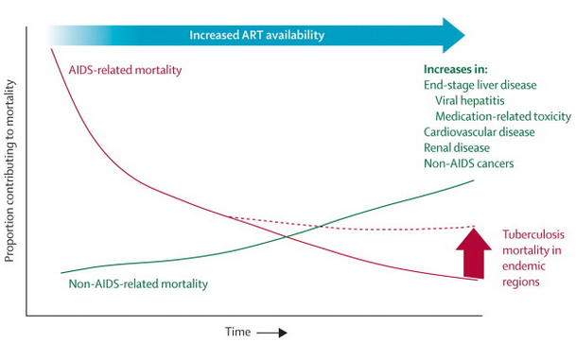
Causes of Mortality as Medication Becomes More Effective
SOURCE: Altice, et al. 2010
Notes:
As time has progressed, AIDS-related mortality among individuals with AIDS has decreased significantly due to the availability and efficacy of antiretroviral treatments. However, increases in other diseases related to aging and exacerbated by comorbid conditions have contributed to mortality across time. Increases in end-stage liver diseases, viral hepatitis, medication-related toxicity, cardiovascular disease, renal disease, and non-AIDS cancer have contributed to mortality.
Tuberculosis mortality is also a concern in regions in which tuberculosis rates remain high due to insufficient resources to treat tuberculosis.
REFERENCE:
Altice, F.L., Kamarulzaman, A., Soriano, V.V., Schechter, M., & Friedland, G.H. (2010). Treatment of medical, psychiatric, and substance-use comorbidities in people infected with HIV who use drugs. The Lancet, 376(9738), 367-387.

Slide 105
Older Adults in Residential COD Treatment (N= 1,400; not HIV-positive)
Older adults used more alcohol; younger adults used more illicit drugs
Older adults had worse treatment retention than younger adults
Treatment retention for older adults most influenced by internal factors (psychological symptoms & problems) while retention for younger adults primarily influenced by external factors (drug use, legal & employment difficulties)
SOURCE: Morse et al, 2014
Notes:
Among older adults in residential co-occurring treatment, older adults were more likely to use alcohol whereas younger adults were more likely to use illicit drugs. Older adults were less likely to remain in treatment than younger adults and were more likely to be influenced by internal factors influencing treatment retention such as psychological symptoms and problems. Younger adults were primarily influenced by external factors in treatment retention, such as drug use and legal or employment difficulties.
REFERENCE:
Morse, S.A., Watson, C., MacMaster, S.A. & Bride, B.E. (2014). Differences between older and younger adults in residential treatment for co-occurrring disorders. Journal of Dual Diagnosis, 11(1), 75-82.

Slide 106

Treatment
Notes:
INSTRUCTIONS
This slide serves as a transition to begin discussing treatment options for older HIV-positive adults who may be experiencing symptoms related to mental health and substance abuse in addition to physical health impairments.

Slide 107
Psychosocial Issues to
Consider in Treatment
Maintaining independence
Social isolation
Spiritual concerns/beliefs
Financial concerns
Physical limitations
Transportation/accessibility
Notes:
Important issues to consider when determining goals and areas of focus in treatment include assisting the individual in:
Maintaining independence: As an individual ages, changes to the family system (children moving away, partners leaving or dying) and decreased mobility can contribute to feelings of social isolation; assisting the individual in identifying and developing skills to feel capable of maintaining independence can improve quality of life as well as emotional functioning.
Spiritual concerns/beliefs: Older adults may have spiritual beliefs or cultural considerations that can be incorporated into treatment in order to develop interventions/coping skills that resonate with the individuals’ existing resources. Connecting information or coping strategies to the individual’s belief system or established rituals can result in more effective engagement.
Financial concerns: Finances can be a burden for individuals who are no longer working and may not have savings to maintain basic necessities with increasing healthcare costs. Additionally, the most prevalent type of elder abuse is financial exploitation with approximately 41 in 10,000 reporting some type of financial exploitation.
Physical limitations: physical mobility may decrease as an individual ages depending on prior physical fitness. Co-occurring disorders and on-going physical ailments may contribute to an individual becoming more sedentary which impacts independent functioning and exacerbates existing conditions.
Transportation/accessibility: older adults who are unable to drive due to physical limitations such as decreases in eyesight may need to find alternatives to attending appointments or getting to the grocery store. Co-occurring disorders such as depression or substance abuse may impact an individual’s motivation to pursue general transportation resources.
REFERENCE:
Lifespan of Greater Rochester, Inc., Weill Cornell Medical Center of Cornell University. & New York City Department for the Aging. (2011) Under the Radar: New York State Elder Abuse Prevalence Study. New York: Author.

Slide 108
Treatment Challenges
Cognitive Impairment
Memory & learning
Focus/attention/concentration
Problem-solving
Decision-making
Reduced vocabulary/ability to recall the exact words they want to say
Notes:
Treatment can also be challenging as a result of the cognitive impairments that may occur as an individual ages. In addition to a reduction in processing time (which may not cause significant impairment in-and-of-itself), co-occurring mental health and substance use disorders can compound changes in cognition. HIV-associated neurocognitive disorders (HAND) can impact cognitive functioning and be exacerbated by substance use or mental health impairments. Providers should have a general sense of the patient’s memory, ability to focus on and learn new information, problem-solving, decision-making and any reductions in vocabulary or abilities to recall words.

Slide 109
Treatment Challenges
Medication Adherence
Already an issue for older adults, many of whom take multiple daily medications for chronic and/or age-related conditions
HIV medications add to this burden
  Not as much in higher-income countries with combination HAART meds requiring once daily dosing but still major issue in lower-income countries where the older meds requiring multiple medications taken 2 or 3 times a day are still prevalent
Then add in medications for MH and/or SUD conditions
Necessity of taking meds at different times of day, before eating or after eating, with or without other medications to avoid interactions, etc
Strong correlation between substance use and medication non-adherence
Notes:
It is critical that treatment addresses issues related to medication-taking and medication adherence as this is an issue frequently experienced by older adults due to the high number of daily medications taken for chronic or age-related conditions. HIV medications, medications for mental health or substance use can add to this burden of keeping track of medications and remembering to take them. In higher-income countries, HAART medications have progressed to being once daily dosing; however, in lower-income countries, dosing is still required two or three times per day. Further complications can arise when medication doses have to be specifically spaced apart or taken with food. Additional side effects could arise depending on the combinations of medications. There is a strong correlation between medication non-adherence and ongoing substance use.

Slide 110
Treatment Challenges
Discussing HIV Risk Behaviors
Talking about HIV risk behaviors with older adults can be challenging
Discomfort on the part of clinicians?
Mistaken assumptions/beliefs about older adults
Older adults may experience stigma regarding open discussion of sexual issues
If older adults do not feel respected, cared about, or heard they may not disclose all risk behaviors
Notes:
Another challenge of treatment is being able to discuss HIV risk behaviors and sexual activity with older adults. As there may be stigma around HIV or discussing sexuality and practice openly, the practitioner needs to be aware of a few factors in the dynamic: talking about behaviors can be challenging as a result of discomfort on the part of the provider and/or the patient; the provider may hold biases or assumptions about older adults that are not accurate or not applicable to the individual. Ensuring that the older adult feels heard and respected is critical in ensuring comfort and on-going engagement which would increase the likelihood an individual would be willing to discuss issues that are uncomfortable and/or risk behaviors.

Slide 111
Treatment Challenges
Disability/Loss of Work
Few AIDS Service Organizations provide services tailored to the needs of older adults
Uncertainty related to aging and the episodic, unpredictable nature of functional impairment in older adults with HIV is central to a conceptualization of HIV-related disability
May feel fine, be functional for a few weeks or a couple of months but then suddenly experience severe fatigue or a GI condition that makes them unable to work
Individual over 50 may continue working until this unpredictable pattern forces them to stop
How to cope with loss of identity, sense of purpose?
Notes:
Few AIDS service organizations provide specific services tailored to the challenges experienced by older adults and the needs experienced by this population. Providers should feel comfortable providing some information related to changes in functioning that could occur as the uncertainty related to aging and potential functional impairments is central to a conceptualization of HIV-related disability for older adults. For example, older adults may feel fine and be functional for weeks or months then experience unexpected or sudden fatigue or other issues that prevent being able to work. Individuals over 50 may continue to work until this unpredictable pattern forces them to stop; at which time the individual may have to deal with loss of identity or a loss of a sense of purpose as tied to an ability to work or provide for self/family in addition to challenges presented by reduced income as a result of not working.
REFERENCE:
Solomon, P., O’Brien, K., Wilkins, S., & Gervais, N. (2014). Aging with HIV: a model of disability. Journal of the International Association of Providers of AIDS Care, 13(6), 519-525.

Slide 112
Exercise: Treatment Challenges
Divide into groups
Each group pick a topic and develop 4-5 specific recommendations for treatment providers on how to address these challenges:
Cognitive impairment
Medication adherence
Discussing HIV risk behaviors with patients
Disability; loss of meaning/purpose
Notes:
INSTRUCTIONS
**Allow 10-15 minutes for this activity; groups should be no less than 3 people and can be as large as 10 or more depending on audience size** NOTE Slides 113-118may be hidden if the presented chooses to substitute the group discussion for reviewing specific information on those slides.
Each group should identify a specific topic as previously discussed and provide recommendations for how to address each of the challenges. Each group should have a recorder who will note the group’s ideas.
Once the groups have had a chance to discuss and write down their ideas, allow them to present the suggestions to the group. This can be done either with the trainer writing information down on a whiteboard or large paper or the group members doing that during discussion.
At the end of the discussion, display the suggestions for each challenge so participants can write down strategies for each challenge.

Slide 113

Cognitive Impairment Strategies
Maintaining Brain Health
Maintain a healthy weight and diet
Attend regular doctor visits and follow treatment plans for any existing illnesses or chronic diseases
Exercise and engage in regular physical activity
Pursue intellectually engaging activities and interactions
Maintain social interactions with family, friends, and community
SOURCE: www.nia.nih.gov/alzheimers/publication/part-1-basics-healthy-brain/changing-brain-healthy-aging
Notes:
Regular doctor visits are critical in maintaining brain health and cognitive functioning as it allows the patient to get up-to-date treatment plans for any illnesses or chronic diseases; it also allow the individual to get updates on healthy weight and diet planning. The behaviors of maintaining healthy weight and diet can be addressed from a motivational enchancement approach. Individuals should exercise regaulrly and engage in physically engaging activities as well as intellectually engaging activities and interactions. Expanding social networks and supports with family, friends, and community assist in improving brain health.
REFERENCE:
U.S. Department of Health and Human Services, National Institude on Aging. (2008). Alzheimer’s Disease Unraveling the Mystery. (Publication No. 08-3782). Retreived from: https://www.nia.nih.gov/alzheimers/publication/part-1-basics-healthy-brain/changing-brain-healthy-aging

Slide 114
Cognitive Impairment Strategies
Modifying Interventions
Reduce length of sessions (attention, memory)
Take structured breaks (attention, focus, memory)
Increase session frequency (practice)
Repeat presentations of therapeutic information (detox, 2 weeks, 4 weeks, 1 month, 3 months, etc.)
Multi-modal presentations—audio, visual, experiential, verbal, hot/cold situations, etc.
Bates, et al., 2013; Huckans, et al., 2013
Grohman, K. & Fals-Stewart, W., 2003, 2009; Medalia, A. & Revheim, N., 2004; & Aharonovich, E., et al., 2003, 2005, 2011
Notes:
Accommodating cognitive impairments involves modifying current interventions in order to deliver information in a way that can be best consolidated and retained by the patient. This includes reducing the length of the sessions to address issues related to attention and memory. The typical “therapy hour” of a 45-minute to 50-minute session in psychotherapy may present too much information to be retained by an individual with difficulties remembering new information or attending for that long of time. Breaking up the session into smaller 15-minute sessions may be useful. This would involve taking structured breaks after each 15-minute session. Presenting information in the first 15-minute session, taking a break to shift the individuals attention and focus, then returning to the session to see what information is retained would be a good way to gauge the patient’s memory. It also provides a break for the individual in between and allow for rehearsal of skills in the second part of the session.
Repetition of information is accomplished by presenting similar information in multiple sessions or potentially increasing the frequency of sessions (from once per week to multiple times per week potentially). Consider ways in which information can be presented in ways beyond just verbal recitation of information. Knowing how individuals who have co-occurring substance use and mental health may have impairments in retaining verbal or word-based information, consider presenting information in a more visual form either writing down information or using other visuals to present the information. This could be audio/visual information (videos, pictures), experiential in which the individual is able to practice a skill or understand the experience personally (if appropriate) or hot/cold situations (in which an individual would “recode” emotional or mental health-related somatic sensations as either hot or cold so as to not have to specifically state what feeling is being experienced.
REFERENCES:
Aharonovich, E., et al. (2005). Postdischarge Cannabis Use and Its Relationship to Cocaine, Alcohol, and Heroin Use: A Prospective Study. The American Journal of Psychiatry, 162(8), 1507-1514.
Aharonovich, E. Nunes, E., & Hasin, D. (2003). Cognitive impairment, retention, and abstinence among cocaine abusers in cognitive-behavioral treatment. Drug and Alcohol Dependence, 71(2), 207-211.
Aharonovich, E., et al. (2011). Nicotine dependence, abuse, and craving: dimensionality in an Israeli sample. Addiction, 106(9). 1675-1686.
Bates, M.E., Buckman, J.F., Nguyen, T.T. (2013). A role for cognitive rehabilitation in increasing the effectiveness of treatment for alcohol use disorders. Neuropsychology Review, 23(1), 27-47.
Grohman, K. & Fals-Steward, W. (2003). Computer-Assisted Cognitive Rehabilitation with Substance-Abusing Patients: Effects on Treatment Response. Journal of Cognitive Rehabilitation, 21(4), 10-17.
Grohman, K., Fals-Stewart, W., Donnelly, K. (2006). Improving treatment response of cognitively impaired veterans with neuropsychological rehabilitation. Brain and Cognition, 60(2), 203-204.
Huckans, M., et al. (2013). Efficacy of Cognitive Rehabilitation Therapies for Mild Cognitive Impairment (MCI) in Older Adults: Working Toward a Theoretical Model and Evidence-Based Interventions. Neuropsychology Review, 23(1), 63-80.
Revheim, D., & Medalia, A. (2003). Verbal memory, problem-solving skills and community status in schizophrenia. Schizophrenia Research, 68(2-3), 149-158.

Slide 115
Additional Cognitive Impairment Compensatory Strategies
Use memory aids— calendars, planners, phone apps, diagrams
Teach stress management, breathing, relaxation, and mindfulness meditation skills
Provide immediate feedback and corrective experiences
Repeat instructions, put things in writing, provide short/direct instructions
Notes:
The use of memory aids (planners, phone apps, calendars) can be useful in ensuring reminders are accessible. This can also be useful in increasing medication adherence. Teaching stress management, breathing, relaxation skills will increase ability to cope. Whenever possible, provide immediate feedback and corrective experiences and ensure that instructions are short and put into writing when possible.

Slide 116
Medication Adherence Strategies
Teach and support use of pill boxes
Increase pts’ understanding of the purpose/importance of each of their medications
Provide pts with list of possible interactions of all their medications, not just HIV meds, and instruct them when/how to take to avoid adverse effects
Develop brief psychoeducational strategies that inform caregivers/significant others how best to support medication adherence
Consider use of technology i.e. cell phone or text reminders
Employ early identification/brief intervention strategies to address substance use, as substance use is strongly associated with medication non-adherence
Notes:
Strategies that will enhance an individual’s medication compliance focus on ensuring the individual is reminded regularly and understands the medications being taken. Teach the individual how to use pill boxes to keep track of and organize medications. An increase in the patient’s understanding of the importance and purpose of each of the medications enhances motivation to take medicines. In consideration of side effects and interactions of multiple medications, provide patients with a list of possible interactions of all their medications and instruct them when/how to avoid adverse effects. Involving caregivers or significant others in assisting with medication adherence is beneficial, as well as utilizing technology (smartphone apps, alerts) if the individual owns and feels comfortable with the technology. Early identification and brief intervention can assist in reducing substance use which is strongly linked with medication non-adherence.

Slide 117
Provider/Patient
Communication Strategies
Employ Motivational Interviewing communication style
  Listen to understand, rather than to diagnosis/fix
  Accept pts where they are rather than judging
  Be genuinely compassionate
  Egalitarian relationship rather than authoritarian
Understand psychological issues related to receiving HIV dx and living with it for many years
  Despite being a manageable, chronic disease, receiving diagnosis is still traumatic
  Stigma by friends, families, communities triggers chronic shame
Notes:
Motivational enhancement techniques employ a style that increases the individual’s insight and awareness while respecting their choice. The intent is to listen to understand rather than to diagnose and fix. The acceptance of the individual where they are rather than judging their behaviors enhances engagement with the treatment provider. The provider focuses on being genuinely compassionate rather than authoritarian.
An understanding of the psychological issues related to receiving and HIV diagnosis and living with it for many years is critical in forming a therapeutic bond between provider and patient. Despite HIV being a manageable, chronic diseases, receiving the diagnosis can still be traumatic and stigmatized by family or friends.

Slide 118
Strategies to Address Disability Status & Loss of Meaning/Purpose
Understanding emotional and psychological impact of HIV diagnosis
Warm handoff and integration
Provide opportunity for self-reflection and reframing
Identifying potential solutions for continuing work
Enhance social interactions
Consider alternative activities
Emphasize positives
Notes:
The impact of HIV extends to the psychological and emotional issues that arise with the diagnosis. Understanding the impact and grief/loss process of receiving the HIV diagnosis, as well as living long-term with the illness, must be addressed in order to ensure that ART treatments are as effective as possible. This may mean multiple systems of care involved in addressing the needs of the individual, including primary care, mental health, and substance abuse. If other providers are involved, “warm handoffs” increase likelihood of participation in treatment services and engagement. Personally introducing the patient to each of the different treatment team members assist in this engagement process. Treatment can also help to gradually reframe the experience as an opportunity for self-reflection; a time to assess where the individual is and where the individual would like to go going forward. This may mean discussing whether the individual has been spending their life doing/being what they want and whether or not this is an opportunity to make some changes that will ultimately allow them to live a happier and more emotionally fulfilling life.
In consideration of the individual’s changes in work, are there opportunities to continue working part-time or in a different capacity while maintaining some consistency of occupation? Identifying opportunities to work with/around friends or family can enhance social interaction and reduce isolation.
Consider also whether this is an opportunity to redefine purpose – has the individual wanted to learn to play an instrument or paint or draw or get in better physical shape but never had time? Validating the grief/loss process and identifying opportunities to reframe how the individual moves forward allow the individual the opportunity to live life more intentionally with specific insight and awareness discussed.

Slide 119
Evidence-Based Treatment Options
Motivational-enhancement therapy
Contingency management
Directly-observed therapy
Medication-assisted treatment
Integrated health services delivery
CBT and Relapse Prevention
SOURCE: Altice, et al. 2010
Notes:
Motivational Enhancement Therapy (MET) employs a variation of Motivational Interviewing (MI) to analyze and dissect feedback gained from client sessions. MI focuses on re-patterning client behavior that is the result of ambiguous and undefined thoughts. This form of therapy is presented in a direct and client targeted manner that strives to transform undesired behaviors. Motivational Enhancement Therapy was developed by William Miller and Stephen Rollnick. The goal of MET is to aid the client in clarifying his or her own perceptions and beliefs in order to direct him or her in a more decisive way. Most people who respond to this type of treatment have struggled for years in a mire of ambivalence and welcome the opportunity to have vision and focus in their lives.
MET is commonly used for the treatment of addictions, including abuse of alcohol and other substances. MET is administered in a receptive atmosphere that allows a client to receive feedback from the therapist for the purpose of fortifying the client’s resolve for transformation and to empower the client with a feeling of self-control. Rather than engaging the client’s defense mechanisms through confrontational discourse, the therapist works with the client to create positive affirmations and a sense of inner willingness to facilitate change. Once that is achieved, the client becomes receptive to the healing process and progresses toward wellness.
Contingency management utilizes behavioral reinforcement theories to enhance the possibility of favorable outcomes occurring with the patient. Contingency management is a systematic application of positive reinforces/rewards (and sometimes punishments) in order to highlight specific behavior and reinforce the occurrence of the behavior in the future. This can include receiving a voucher that can be redeemed for specific items following a negative urine screen or certain number of months without having used. It may be a point-based system attached to certain privileges or it could be a slight reduction in fee for services with demonstrated success in working toward treatment goals.
Directly-observed therapy is a specific supervisory technique to ensure that the provider is receiving real-time support in addressing issues and interpersonal dynamics between the provider and the patient. It may involve a recorded session that is debriefed later or the use of technology to provide real-time suggestions to the provider during session.
Medication-assisted treatment employs various medications to assist with reducing substance use; specifically demonstrated effects with opioid abuse and alcohol abuse. MAT provides on-going or acute support in assisting an individual to reduce use or detox from use of illicit drugs or alcohol.
Integrated health services delivery enhances the communication between providers and with the patient. Integrating different health providers provide the most comprehensive conceptualization and treatment planning for multiple conditions and diagnoses. Communication is critical in establishing goals and maintaining progress in treatment.
CBT and Relapse Prevention involve the identification of the interaction between thoughts, feelings, and behaviors in engaging in maladaptive coping behaviors such as substance use. Increasing insight and awareness assists in identification of appropriate coping skills. Relapse prevention includes specific identification of scenarios in which the patient may be triggered to use and develops specific refusal techniques and coping skills to enhance the individual’s feelings of confidence in preventing relapse.
Behavioral interventions for HIV prevention should address the link between substance use and HIV/STD by focusing on high-risk sexual behaviors that are consequences of substance drug use, most commonly alcohol consumption. The focus for HIV prevention has been on effective interventions such as condom use, testing and counseling, pre- and post-exposure prophylaxis (preventive medicine), male circumcision, needle exchange services to reduce needle sharing that may lead to HIV transmission for injecting drug users. However, there is need to pay more attention now to preventing and treating non-injectable drug use including alcohol, which can interfere with these efforts, impairing people’s judgment and making them less likely to use protection during sex. Preventing and treating substance use can reduce the incidence of substance induced high-risk sexual behaviors and subsequently reduce HIV transmission.
REFERENCE:
Drug Abuse and HIV/AIDS: The Role of Alcohol. Published on May 3, 2012. Available at: http://www.drugs.indiana.edu/drug-info/featured-articles/157-drug-abuse-and-hivaids-the-role-of-alcohol

Slide 120
Screening & Identification of Alcohol Misuse Among Older Adults
SBIRT
Screening, Brief Intervention, and Referral to Treatment (SBIRT)
Administer brief alcohol screening instrument to all patients in primary care settings, at least annually
Identify those with “risky” or “hazardous” drinking who may respond to a brief intervention by healthcare provider
Those with severe alcohol misuse are connected with appropriate SUD treatment resources
Notes:
This slide presents information on Screening, Brief Intervention, and Referral to Treatment (SBIRT), a mechanism to be used in primary care setting to screen for an address alcohol use. The screener identifies individuals who may be using alcohol at a “risky” or “hazardous” level and would otherwise not receive any interventions regarding alcohol use. These individuals receive a brief intervention with the healthcare provider while individuals identified as having more severe alcohol misuse behaviors are connected with appropriate substance use disorder treatment resources. SBIRT can be used with adults of any age.

Slide 121
SBIRT
FL BRITE Project
SBIRT for older adults (Schonfeld et al, 2015)
Florida BRITE Project (Brief Intervention and Treatment for Elders) 2006-2011:
  N = 85,000; all received SBIRT screening in healthcare, behavioral health, aging-related services i.e. home healthcare/support
  Age 55 and up
  9.6% screened positive for moderate to high risk on ASSIST screener
  Of those (n=8,165)
Notes:
The SBIRT model has been applied to older adults specifically though a Florida study aimed at determining the efficacy of the Brief Intervention and Treatment for Elders (BRITE) Project to address the unmet need to identifying problematic drinking and delivering a brief intervention among older adults. Between 2006 and 2011, 85,000 adults 55 and up in Florida received alcohol screening in healthcare, behavioral health, and aging-related services. It was found that 9.6% (8,165) of older adults screened positive for moderate to high risk drinking on the ASSIST (Alcohol, Smoking, and Substance Involvement Screening Test; a World Health Organization screener).
REFERENCE:
Schonfeld, L., et al. (2015). Screening, brief intervention, and referral to treatment for older adults with substance misuse. American Journal of Public Health, 105(1), 205-211.

Slide 122
SBIRT
FL BRITE Project - Alcohol
Substance use in past 30 days | N = 8,165
Used any alcohol | 58.7%
Used alcohol to intoxication | 31.1%
Intoxication with 5 or more drinks | 18.7%
Intoxication with 4 or fewer drinks | 21.9%
Used illegal drugs (didn’t separate rx meds from illicit drugs) | 13.1%
Notes:
Among the 8,165 individual in the Florida BRITE Project who identified as having used any illicit drugs or alcohol in the past 30 days, 58.7% reported using any alcohol at all. 31.1.% reported using alcohol to intoxication with cutoffs for intoxication being 5 or more drinks or 4 or fewer. 13.1% of individuals reported using illicit drugs during the past month though the study did not separate prescription medications being used for a non-medically directed purpose from illicit drugs.

Slide 123
SBIRT
FL BRITE Project - Depression
Individuals with positive PHQ-2 screen received longer depression assessment: Geriatric Depression Scale - Short Form | N = 6,641
Depression (None to mild) | 13.3%
Depression (Moderate) | 73.0%
Depression (Severe) | 13.7%
Take-away message: 87% of a sample of older adults screening positive for possible depression on the PHQ-2 reported moderate to severe symptoms on the GDS-SF
Notes:
The participants in the SBIRT Florida BRITE Project also completed information related to depression. If an individual scored positive on the brief Patient Health Questionnaire – 2 (PHQ-2), they would receive a longer assessment using the Geriatric Depression Scale – Short Form. Of the 6,641 individuals who screened positive on the PHQ-2, 73% reported moderate depression, while none-to-mild depression was reported by 13% and severe depression was reported by 13%. This indicates that 87% of older adults who screened positive for possibly depression actually reported moderate to severe symptoms on the longer assessment.
Additional Information for the Trainer(s)
Alcohol-dependent patients should be referred to treatment programs. HIV clinicians should be familiar with local resources for substance-abuse treatment and related psychiatric care, including inpatient or residential treatment, outpatient treatment, and support groups such as Alcoholics Anonymous. In addition, clinicians should assess for potential withdrawal symptoms. Clinicians should also consider the use of pharmacotherapy in dependent individuals. Medications are available that target neurotransmitters involved in the reinforcing effects of alcohol use. Pharmacotherapy for alcohol dependence in combination with behavioral counseling can reduce relapse and help maintain abstinence. HIV clinics offer a number of advantages as a site for alcohol pharmacotherapy. These clinics are involved in long-term patient care, are generally characterized by integration of a variety of specialty services (e.g., psychiatric and OB/GYN services), and have access to funding for prescription medications. Further, many HIV clinics use intensive case management models that promote outreach to and retention of patients who are often challenging to treat. However, currently there are no data on pharmacotherapy for alcohol dependence in patients with HIV infection, although a number of trials are under way. Further, pharmacotherapy for dependence has shown only modest efficacy in clinical trials.
Other interventions clinicians can do include: (1) offer patients an HIV test as a regular part of medical care; (2) offer patients STD testing and treatment services; (3) engage patients in HIV treatment and make sure the amount of virus is as low as possible; (4) engage and encourage people with HIV continue getting HIV medical care; (5) provide HIV prevention counseling to patients on how to protect their health and avoid passing the virus on to others; and (6) refer to other prevention services (for example, partner counseling) as needed.

Slide 124
Local Resources
LALGBTC HIV over-50 support group
http://www.lalgbtcenter.org/hiv_over_50
The Los Angeles LGBT Center offers a free, drop-in support group facilitated by mental health professionals and focuses on issues ranging from medications impacts to the psychological impact of coping with HIV/AIDS.
Notes:
This slide features resources to local referrals.

Slide 125
Resources for Providers
NIH Alcohol-Drug-HIV infographic
http://www.drugabuse.gov/related-topics/trends-statistics/infographics/drug-alcohol-use-significant-risk-factor-hiv
SAMHSA TIP 26: Substance Abuse Among Older Adults
American Academy of HIV Medicine “Recommended Treatment Strategies for Clinicians Managing Older Patients with HIV”
https://www.aahivm.org/Upload_Module/upload/HIV%20and%20Aging/Aging%20report%20working%20document%20FINAL%2012.1.pdf
Notes:
This slide features online resources for providers to learn additional information about drug use, HIV, and older adults.

Slide 126
Resources: NYS DOH Reference Cards
HIV in Older Adults
http://www.hivguidelines.org/clinical-guidelines/hiv-and-aging/hiv-in-older-adults-a-quick-reference-guide-for-hiv-primary-care-clinicians/
Mental Health Screening and HIV
http://www.hivguidelines.org/clinical-guidelines/quick-reference-cards/mental-health-screening-a-quick-reference-guide-for-hiv-primary-care-clinicians/
Substance Use Screening and HIV
http://www.hivguidelines.org/clinical-guidelines/quick-reference-cards/substance-use-screening-a-quick-reference-guide-for-hiv-primary-care-clinicians/
Notes:
This slide features printable reference sheets on HIV and older adults, mental health and substance use screening topics from the New York State Department of Health.

Slide 127
What did you learn?
Notes:
INSTRUCTIONS
The purpose of the following five questions is to test the post-training knowledge as it relates to the topic of Older Adults, Substance Abuse, and HIV. The five questions are formatted as either multiple choice or true/false questions. Read each question and the possible responses aloud, and give training participants time to jot down their response before moving on to the next question. Reveal the correct answer to each question.

Slide 128
Post-Test Question
Over 20% of older adults in the US in 2012 were living below poverty level.
A. True
B. False
Notes:
Answer Key:
Correct response: A (True)

Slide 129
Post-Test Question
By the year 2040, older adults will make up ______% of the total US population.
A. 10
B. 20
C. 30
D. 40
Notes:
Answer Key:
Correct response: B (20%)

Slide 130
Post-Test Question
Between June 2013 and June 2014, the age group that had the highest increase in new cases of HIV in California was:
A. 13-19
B. 20-29
C. 50+
D. A and C
E. A and B
Notes:
Answer Key:
Correct response: D (A and C)

Slide 131
Post-Test Question
Older adults infected with HIV show lower rates of viral suppression on ARTs when compared to younger adults.
A. True
B. False
Notes:
Answer Key:
Correct response: B (False)

Slide 132
Post-Test Question
Debilitating cognitive impairments as an individual gets older are typically the result of:
A. A normal aging process
B. Substance use
C. HIV infection
D. Both B and C
E. All of the above
Notes:
Answer Key:
Correct response: D (Both B and C)

Slide 133


Thank You For Your Time!
Thomas E. Freese, PhD: tfreese@mednet.ucla.edu
Andrew Kurtz, MFT: askurtz@mednet.ucla.edu
James Peck, PsyD: jpeck@mednet.ucla.edu
Kevin-Paul Johnson: kevinpaul@HIVtrainingCDU.org
For additional information
on this or other training topics, please visit:
www.psattc.org
www.uclaisap.org
Notes:
This concludes the presentation. Thank the participants for their time and address any last-minute questions about the content. Encourage participants to reach out to the Pacific Southwest ATTC or Pacific AETC, should they have questions or concerns following the training session.

